Slide 1
Notes:
Notes for teachers:
Barnardos is Ireland’s largest children’s charity and we help transform the lives of vulnerable children. Our mission is that all children in Ireland get to reach their potential. With support from Google.org, the Barnardos Online Safety Programme delivers workshops or webinars in schools about how to be safe online. These workshops take a positive approach to online safety, asking children to be S.T.A.R.s online and to learn 4 simple rules to be safe, resilient and positive online.
S – stay safe online
T- think smart
A – ask for help
R is for reach out and be kind
To compliment these 45 minute workshops, we’ve also developed these lesson plans for teachers to help expand on the messages we’ve given. This is the first lesson that looks at S for stay safe. There is a worksheet that compliments the lesson and it has 6 activities attached to it.
The lesson in total should take about 45-60 mins depending on how much discussion you have. There are 4 parts to it:
Discussion around likes/risks of the internet
Sharing personal information + a game
Grooming and how to talk to strangers in games
The importance of creating strong passwords (with practice activities)

Slide 2
Hello and welcome
For students in 3rd to 6th class
Sarah
Tadhg
Aoife
Rob
Notes:
Notes for teachers:
Our workshops and lesson plans are designed for 3rd-6th class. There will be adaptation and extension activities in the notes so you can amend as per your class maturity level and experience.
In each lesson plan and rule students learn, they are introduced to a different character. They make up an Online Safety Band, their names are Sarah, Tadhg, Aoife and Rob. These slides focus on Sarah, but watch out for other lesson plans that look at the other rules.

Slide 3
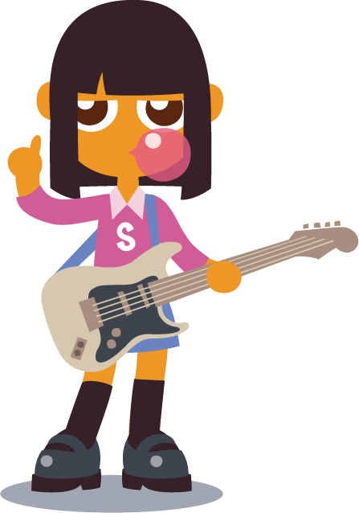
Notes:
Notes for teachers:
This lesson is all about Sarah, and trying to help her stay safe online.

Slide 4
What do you use the internet for?
Notes:
Notes for teachers:
At Barnardos, we take a positive approach to online safety, knowing what a great resource the internet can be for children, when used safely. We always like to start with positives in our workshops.
2 minutes
General discussion about what students like to do online and what they use the internet for – 1) to create things, 2) for fun? 3) to learn things or 4) to talk to their friends
Show them next 4 slides to give them inspiration about different games/apps or websites they might like to use
Pair work or group work

Slide 5
To create?
Notes:
Do you use the internet to create things?

Slide 6
For fun?
Notes:
Do you mostly use the internet for fun?

Slide 7
To learn new things?
Notes:
Do you use the internet to learn new things?

Slide 8
To talk to others?
Notes:
Do you use the internet to talk to others?

Slide 9
To create?
To talk to others?
For fun?
To learn new things?
Notes:
I’ll give you a minute to talk to the pod beside you.
Pair work – What do you use the internet for?
Feedback as a group

Slide 10
Do activity 1 on your worksheet
Notes:
Optional – write their answers into their worksheet

Slide 11
What do we need to be careful about online?
Notes:
Notes for teachers:
While we know the internet can be really helpful, we also know there are also things online that are not safe for children and things we need to be careful about.
Brainstorm together, before showing them the icons. What do we need to be careful about online?
Coming up one at a time, what do you think these symbols mean? Take out your worksheet and match up the image to the description

Slide 12
Do activity 2 on your worksheet
Notes:
20 seconds
Quick solo activity
Match up the 3 images to their description

Slide 13
What do we need to be careful about online?
A) You need to be careful about your personal information online and not share it with others online. Your passwords need to be very strong.
1.
2.
C) Scammers/hackers are people who are not who they say they are.
B) Whatever is written online stays there forever, so it is like a permanent marker. You need to be careful when you post a comment/photo or video online as once it is gone on the internet, it isn’t yours anymore and it is very hard to take back.
3.
Notes:
Let’s review the answers together
Answer sheet
1- A
2 – C
3- B

Slide 14
Notes:
Notes for teachers
This lesson is all about trying to help Sarah stay safe online. She is the leader of her online safety band and even though she isn’t old enough, she uses social media to publicise their next gigs. Sometimes she isn’t very safe though and she shares too much personal information. She also isn’t private on these social media accounts so anyone who googles her name, these accounts will come up.

Slide 15
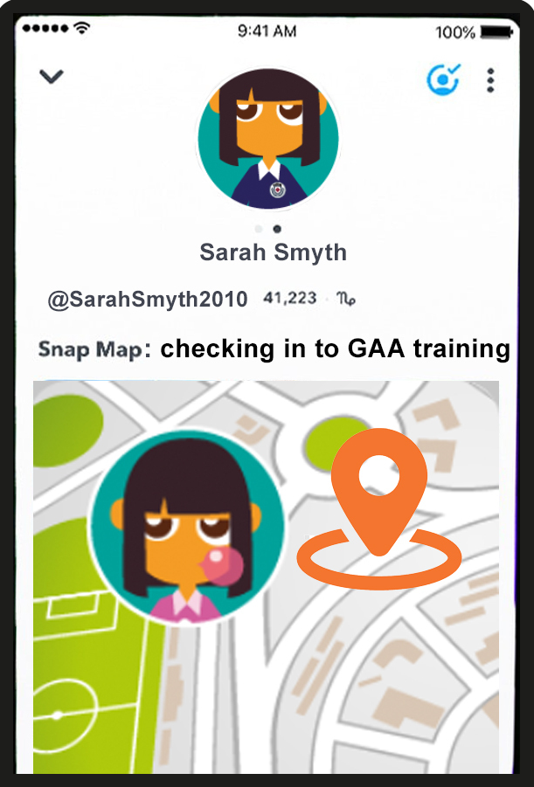
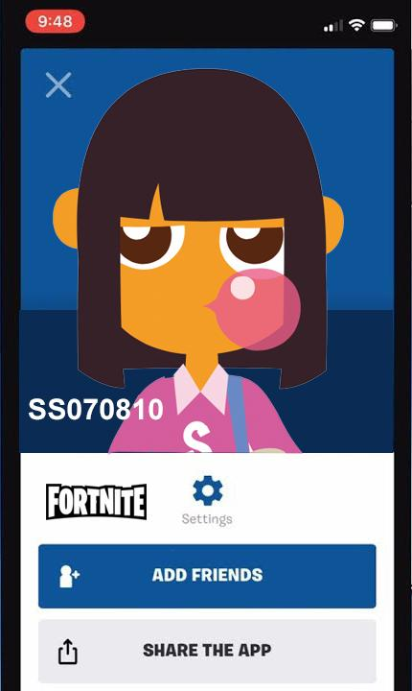
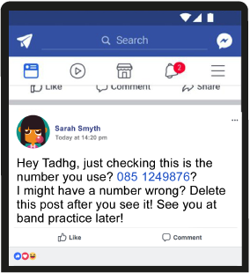
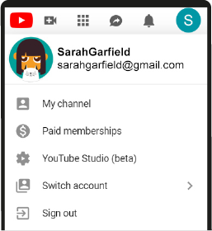
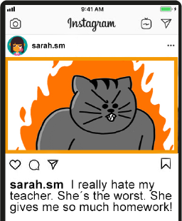
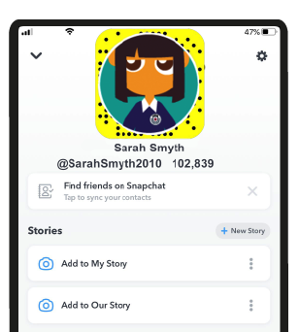
What do people
normally
share online?
Notes:
Notes for teachers
What do people normally share online (to come up first)
Pictures
Comments
Videos
Emails
Memes/gifs
Let’s have a look at what Sarah has been sharing online recently

Slide 16
What information should
we not share online?
Notes:
Notes for teachers
So we can see in the last slide that Sarah shares a bit too much online. What things do you think we shouldn’t share online?
Yes, things that are personal to you. These are called your personal information. They are things like your address, your phone number, your date of birth. Let’s have a look at what Sarah shares in more detail.

Slide 17
You shouldn´t share
personal information online
Her first name, picture and email

Slide 18
You shouldn´t share
personal information online
Tadhg´s mobile number
Notes:
Her friend Tadhg’s mobile number

Slide 19
You shouldn´t share
personal information online
Date of birth

Slide 20
You shouldn´t share
personal information online
Her school,
her name and year of birth
Notes:
She shares a picture of herself in her school uniform. It is easy to zoom in on a crest and you will know what school she goes to.

Slide 21
You shouldn´t share
personal information online
Her location
Notes:
This is using the GPS chip in your phone to pinpoint exactly where you are. It is great in Googlemaps, but it isn’t so good on social media, especially if you have lots of followers/friends and you don’t know them in real life. You are telling everyone where exactly you are at that moment.

Slide 22
Let’s learn more about personal information
Notes:
Notes for teachers
So you’ve seen the types of things that Sarah has been sharing and it isn’t great. Let’s check what you would share. We know not to share personal information online– do you know what that is? Let’s play a quick game to find out.

Slide 23
Do activity 3 on your worksheet
Notes:
Notes for teachers
You can play the game first with your students, or you can ask your students to write their answers and their reasons why in their worksheet first either.

Slide 24
Let’s play Should I keep it safe? Or share away?
Full name?
Notes:
Notes for teachers:
For this game, everyone needs to stand up. You will see lots of different examples coming up in a second.
If you think it is personal information and you SHOULDN’T share it online, you cross your hands and you say ‘keep it safe’. If you think it is fine to share on the internet, you open your arms outwards and yo usay ‘share away’.
Will we have a quick practice?
The first one is FULL NAME. What do you think? Keep it safe or share away?
You’re right, we need to KEEP THIS SAFE. When you have a profile name, you can use a username, but best not to use your real first and second name.

Slide 25
Should I keep it safe? Or share away?
Favourite ice-cream?
Notes:
Favourite ice-cream? Keep it safe or share away?
Yes, you can share this online. Your favourite ice-cream is fine to share on the internet, this isn’t your personal information.

Slide 26
Should I keep it safe? Or share away?
Phone number?
Notes:
Your phone number – keep it safe or share away?
Most of you probably don’t have phones yet, but yes, you should keep this safe and not share it online. If your account is not private, like Sarah’s, you don’t know who might contact you on this phone number.

Slide 27
Should I keep it safe? Or share away?
Date of birth?
Notes:
Date of birth – keep it safe or share away?
Yes, keep that safe. This is personal information just for you and you shouldn’t share it with others online.

Slide 28
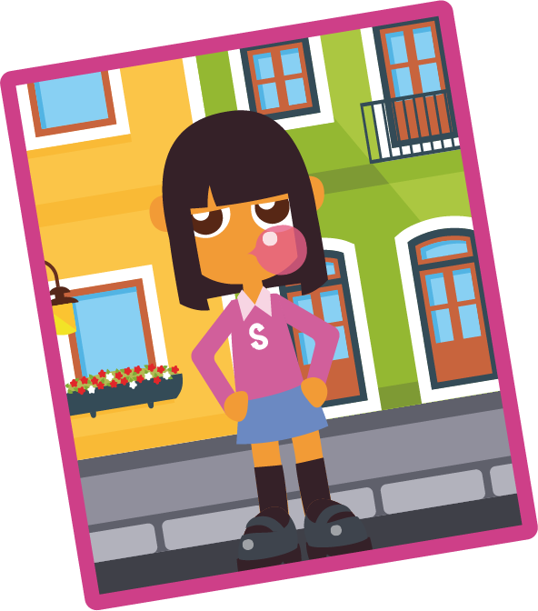
Should I keep it safe? Or share away?
A picture in front
of your house?
Notes:
A picture in front of your house – keep it safe or share away?
Yes, keep that safe. Like Sarah using the ‘check in’ system on Snapmaps, you don’t want to share photos that give too much personal information away. Other people on the internet (strangers) will know where you live potentially if you share this.

Slide 29
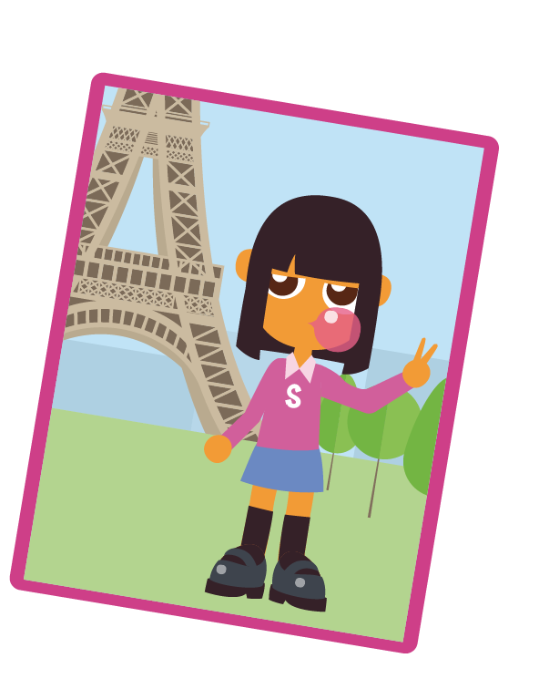
Should I keep it safe? Or share away?
A picture in front
of the Eiffel tower?
Notes:
A photo in front of the Eiffel tower- keep it safe or share away?
Yes, you can share this. It doesn’t give personal information away about you, it just explains you were on holidays.

Slide 30
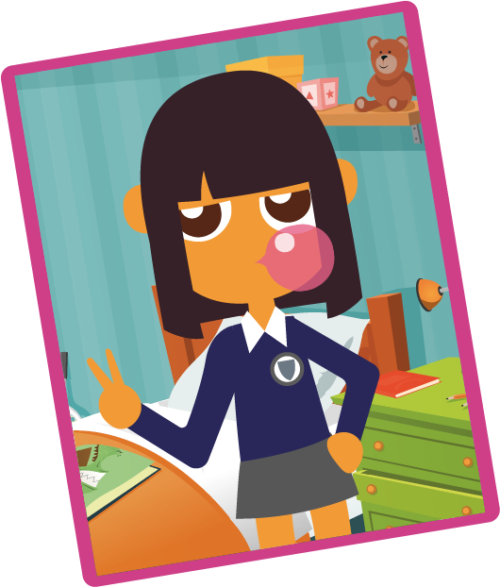
Should I keep it safe? Or share away?
A picture of you
in school uniform?
Notes:
A picture of you in your school uniform – keep it safe or share away?
Yes, definitely keep that safe. As we know from Sarah, it is so easy to zoom in on the school crest and then people would know where you go to school. If you add all these images together, people online would know a lot about you, which isn’t great.
Extension activity (6th class)
On the subject of sharing photos of yourself.
1) What about a picture of you at the beach – keep it safe or share away? Probably isn’t giving any personal information away here so as long as it isn’t an embarrassing photo and your swimming togs are on just right, it might be OK. Or if you’re at the beach on a nice walk with friends, that is fine too.
2) A photo of you just after a shower in your towel? – Keep it safe or share away? This doesn’t give personal information away, but it isn’t appropriate to share images when you’re not fully wearing your clothes. If it goes on the internet, it isn’t yours anymore and it is very hard to take down.
Depending on the maturity level of your 6th class, you could explain if you take a naked picture of yourself and share it with others on the internet, you’ve actually broken the law – the Child Trafficking and Pornography Act 1998. It says if you’re under 18 and you take a naked picture, you’ve broken the law as you’ve created an indecent image of a child. If you send it, you’ve distributed an indecent image and if you have it on your phone, you’re in possession of an indecent image. This has happened in real life to a 12 year old who sent a topless picture as a dare to a whatsapp group, but then lots of people shared it and the police got involved.
If you want to develop the concept further, you can show them this video
Cartoon from NSPCC “I saw your willy Alex” - made for 8-10 year olds to address the topic of sexting: https://www.youtube.com/watch?v=z1n9Jly3CQ8
Or you could show them this video
Video from webwise, called “Forever” - made for 1st/2nd years to address sexting - https://www.youtube.com/watch?v=wExUOx5V73I&t=2s

Slide 31
Do activity 3 on your worksheet
Notes:
Notes for teachers
You can play the game first with your students, or you can ask your students to write their answers and their reasons why in their worksheet first either.

Slide 32
Remember, in online gaming,
talk only about the game, not about your personal information
Notes:
Notes for teachers
Moving on from images that you share online, sometimes you might be talking to other people online when you are gaming. I know you all know not to share personal information about yourself to strangers on the street, but sometimes when children are playing video games, they might overshare information about themselves to their online friends.
Remember, if you have online friends that you game with, firstly it is better to only add people online that you know in real life. However when you’re gaming, it is important you only talk about the game and not about your own personal information.

Slide 33
The correct way
to talk online
Scenario 1
Notes:
Notes for teachers:
Let’s see how best to talk to others online in a game
You can see here, it is fine to have fun online and talk about the game.
Extension for 6th class (if they need it and are mature enough and challenge why this is important.
https://www.bbc.com/news/av/uk-england-essex-45576031 – this is a real life example of someone who became friends with an online gamer who eventually groomed and killed him. Breck Brednar was 14 years old and the person who killed him was 17

Slide 34
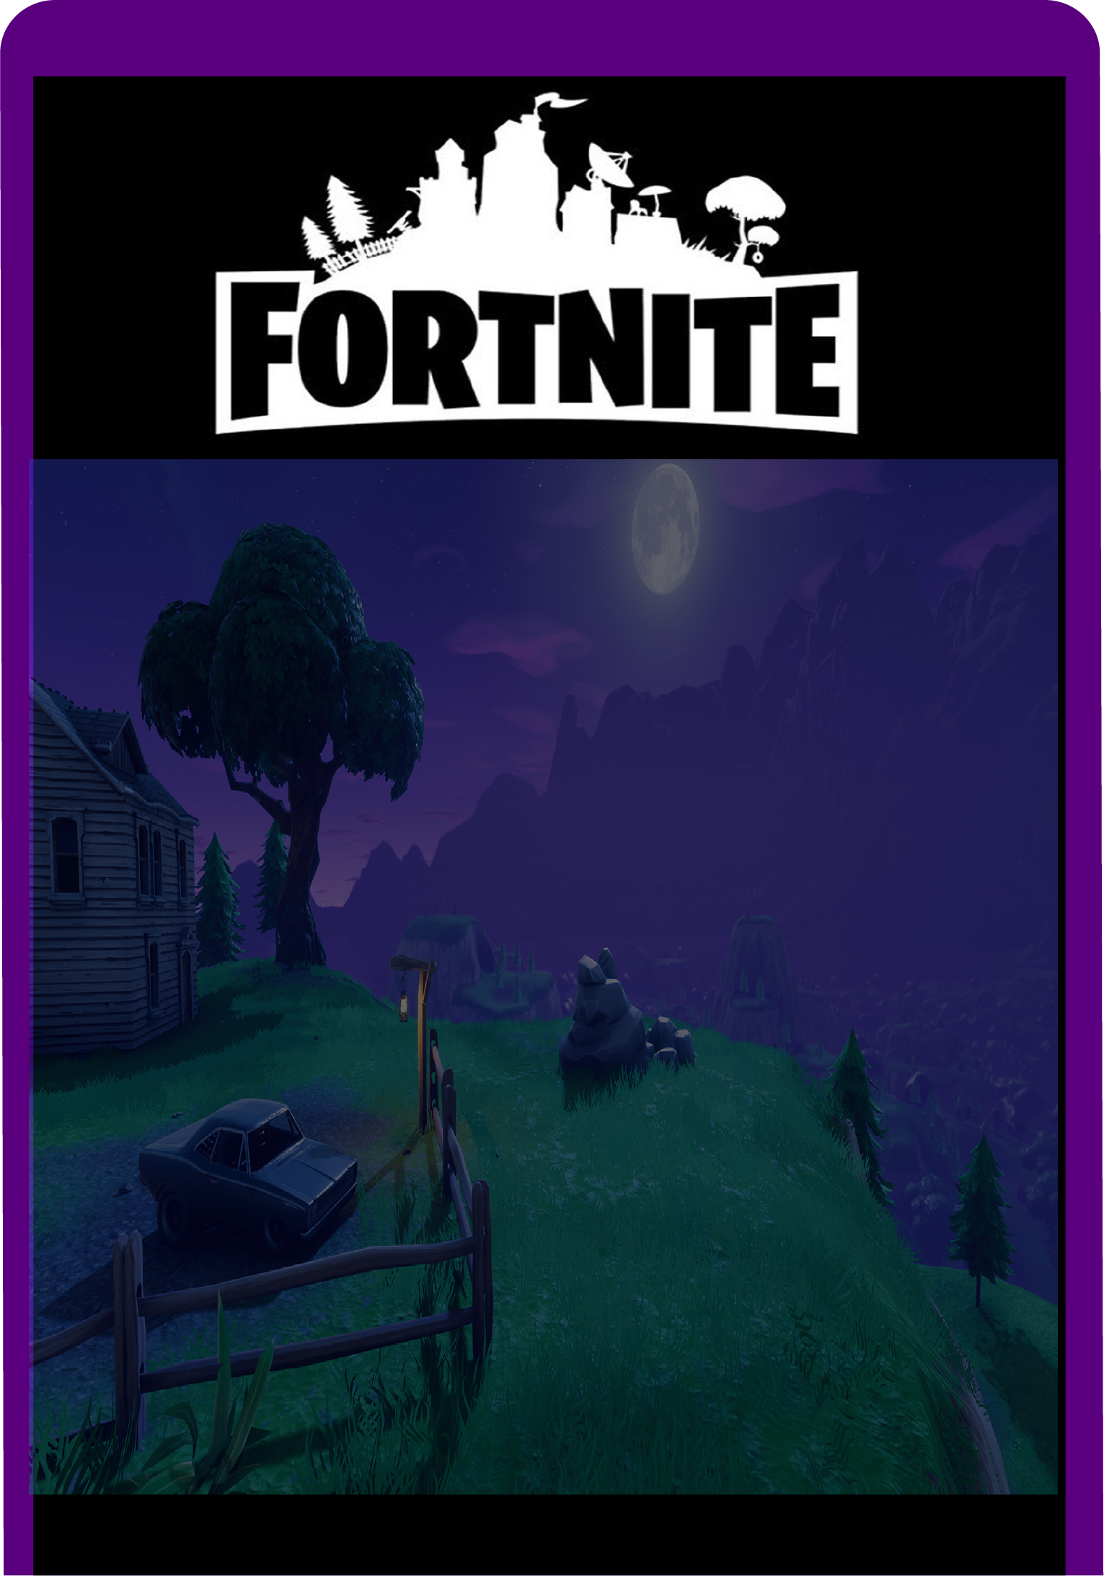
Remember,
don´t give away any personal information
Scenario 2
Notes:
Notes for teachers
This is an example of a red flag – things to watch out for when you’re gaming with others online. If they ever start asking your personal information, flatter you or ask you to go onto a different platform, this could be dangerous and you always need to tell your parents if this happens. You should block and report this person too.

Slide 35
Imagine scenario 2 happened to Sarah when she was on Fortnite and was playing with someone she didn’t know in real life.
What should Sarah do?
A) Write back and be friendly. Ignore the personal comments?
B) Write back and say no thanks, I don´t know who you are? Ask her parents for advice.
C) Block and report this person to the game and tell her parents?
D) Nothing, just mute that person and continue playing?
Notes:
Notes for teachers
Imagine scenario 2 happened to Sarah. In the example, Sarah writes back and shares her mobile number. What do you think Sarah should do? Talk to the person beside you and see which option you would choose A), B), C) or D)?
Have a chat with the person beside you and then write your answer and the reason why in your worksheet.

Slide 36
Do activity 4 on your worksheet
Notes:
Notes for teachers:
Allow time to fill out their activity sheet

Slide 37
What should Sarah do?
A) Write back and be friendly. Ignore the personal comments?
B) Write back and say no thanks, I don´t know who you are? Ask her parents for advice.
C) Block and report this person to the game and tell her parents?
D) Nothing, just mute that person and continue playing?
Notes:
Notes for teachers:
Feedback as a group
Hands up who said A), hands up who said B), hands up who said C), hands up who said D)
Be careful about this. It is fairly clear that you don’t know this person in real life. It is a bit odd that they have asked for your mobile number ,it is best not to write back and to block instead. A person in the street wouldn’t just ask for your number like that!
Yes, this is a good option and is very safe. Always tell a trusted adult and you shouldn’t get in trouble for doing so
Yes, this is another good option
Yes, I suppose you could do this, but it is always better if anything makes you feel uncomfortable on the internet, you should always tell your parents. You may need to block this person and it is probably best to report this person as well.

Slide 38
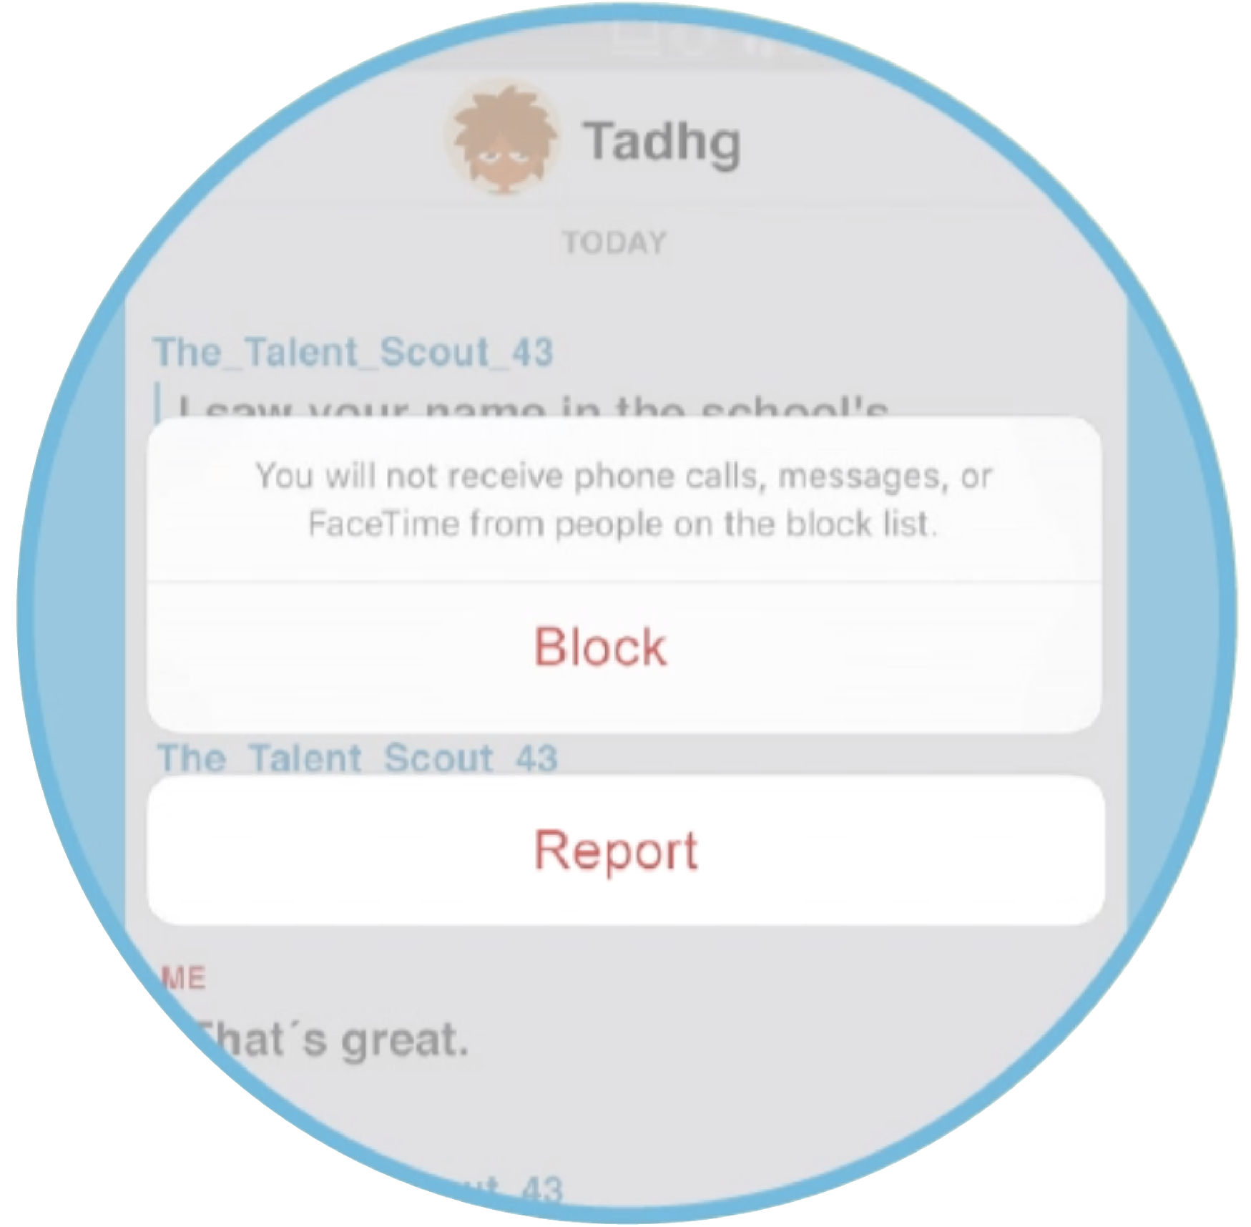
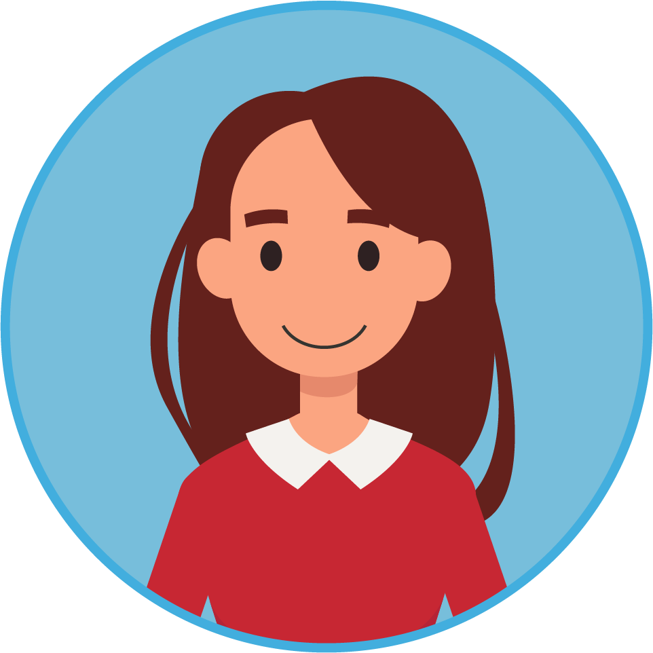
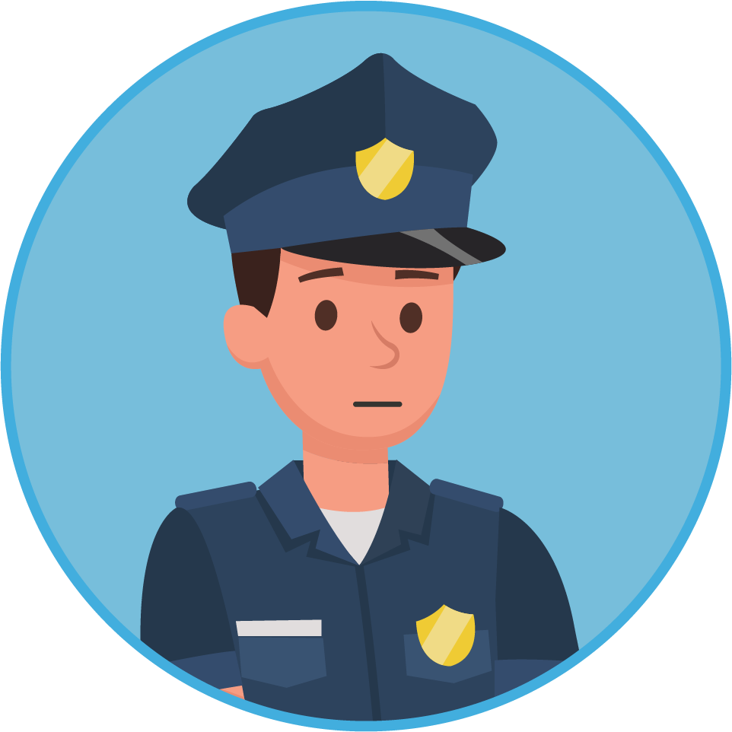
Unwanted contacts
If you get a strange feeling, trust your gut and do the following:
You can always
block/ report
Tell a trusted adult like your parents or teacher
In some situations, the guards can be involved
Notes:
Notes for teachers:
If anyone makes you feel worried or you get a strange feeling from someone, you should trust your gut and do the following. You shouldn’t keep these feelings inside, it is so important that you tell a trusted adult as it can be serious sometimes.

Slide 39
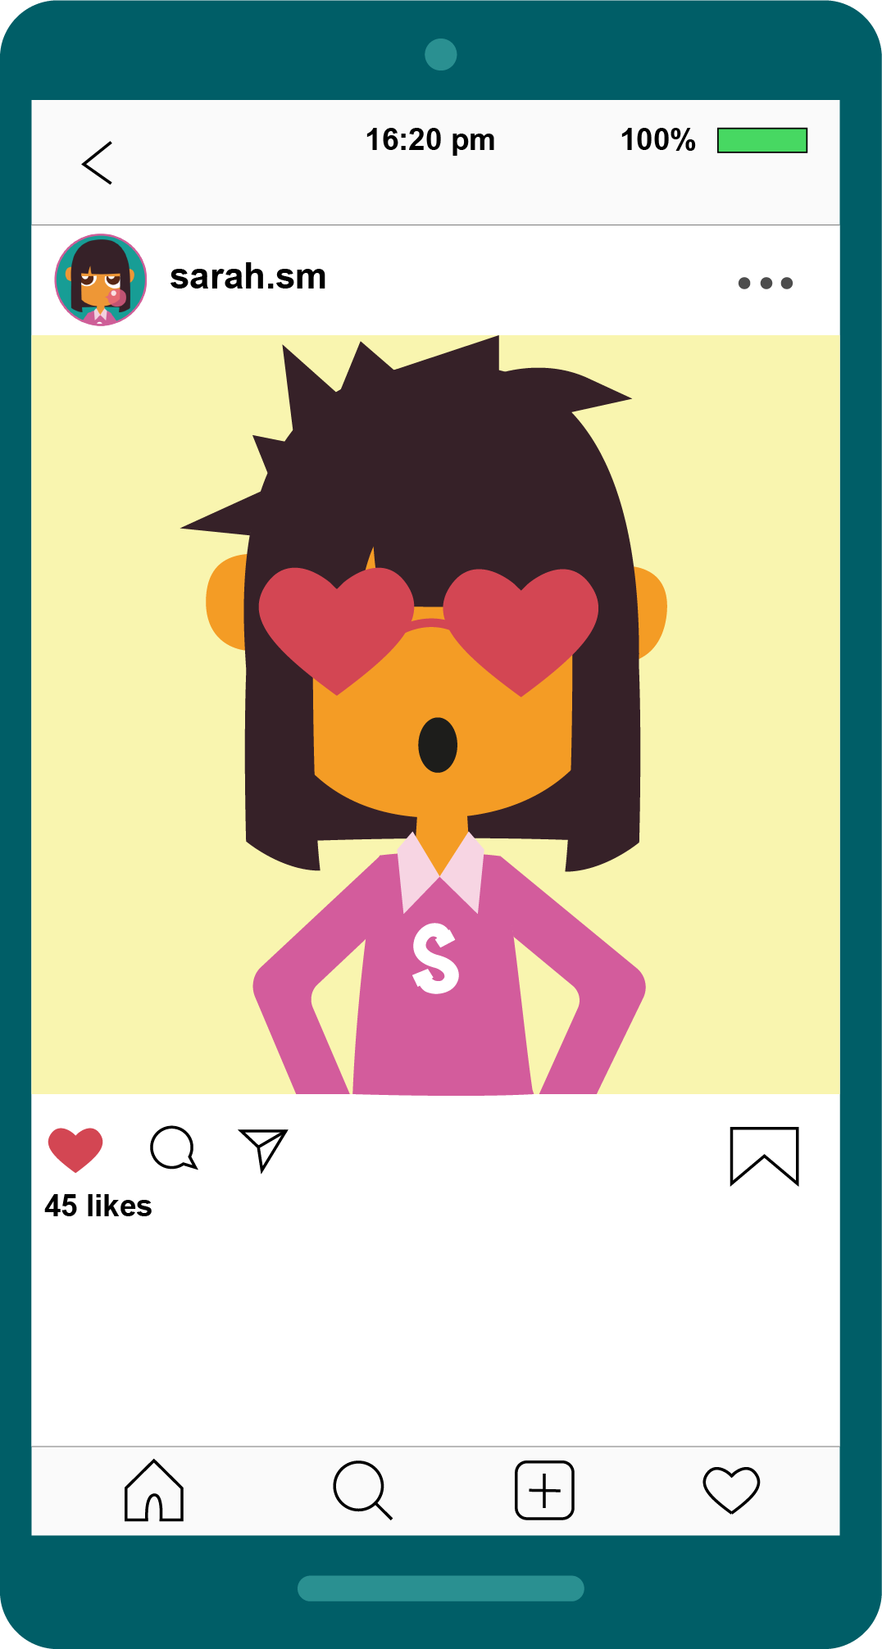
The importance of passwords
sarah.sm Hey I didn´t post that!
Tadhg Oh, wasn´t Claire on your phone a while ago?
Notes:
Notes for teachers:
We’ve talked about sharing images, not sharing personal information, not giving personal information away to strangers online. The last thing to do is to look at why keeping strong passwords is important to staying safe online.
Look at this Instagram post. What do you think is happening here? There is a funny picture of Sarah, it looks like it is Sarah who posted this picture as it is in her account, but then Sarah comments on this picture and says ‘hey I didn’t post that’. Then Tadhg says ‘wasn’t Claire on your phone a while ago?
What do you think happened here? I’ll give you a minute to chat to the person beside you about this.
Feedback as a group – yes, it looks like Claire knew Sarah’s password, logged in as Sarah and posted this funny picture of her.

Slide 40
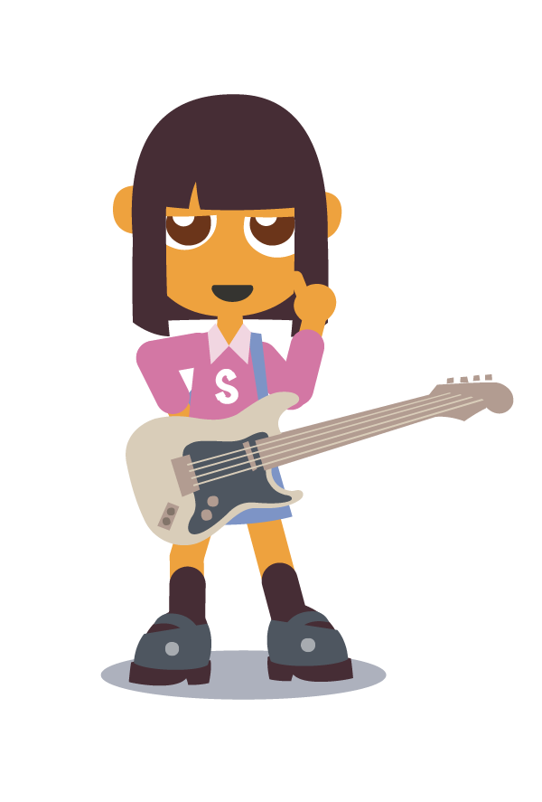
What should Sarah do?
A) Take down the image and report it
B) Tell her parents
C) Change her passwords
D) Always log out of accounts
E) All of the above
Notes:
Notes for teachers:
So, what should Sarah do next? Let’s go through some options.
What do you think?
Feedback as a group – yes E) all of the above is the correct answer. Maybe Claire thought what she did was funny, but it wasn’t funny to Sarah!

Slide 41
STRONG PASSWORDS
How to stop the hackers
What are these?
123456
SSGarfield2010
aaaaaa
111111
password
Notes:
Notes for teachers:
So we know that Sarah isn’t always safe and either doesn’t log out of accounts, or has really easy passwords for others to guess. What do you think these are?
123455? 111111? Password?
Yes, that’s right. These are some of the easiest passwords to guess as they are the most common.
SSGarfield2010 is an example of what Sarah’s password MIGHT be. You would know all this information from the social media posts she is sharing about herself.

Slide 42
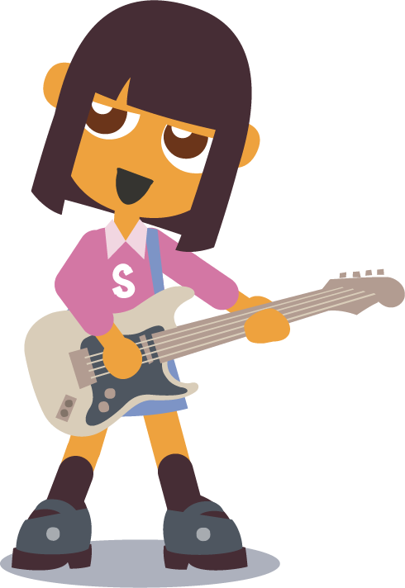
How to make a strong password
I play the guitar.
ipl@y#gtr
Notes:
Notes for teachers:
At Barnardos, we always say that to have a strong password, it is better to make a sentence that you remember, but that you make harder for others to guess with icons/numbers etc.
For example, Sarah’s password could be ‘I play the guitar’. But instead, she changes the a to the @ symbol and uses # for the

Slide 43
Practice making up passwords
See if you can
make up a
password?
Notes:
Notes for teachers:
Now, your go! Look at your worksheet and see if you can change these sentences into harder to guess passwords!

Slide 44
Do activity 5 on your worksheet

Slide 45
Practice making up passwords
See if you can
make up a
password?
I ate Bananas in 2020
i8bananas@2020
Notes:
Notes for teachers:
Is this how you changed the sentence? How is yours different?

Slide 46
Do activity 6 on your worksheet
Notes:
Notes for teachers:
Fill out worksheet 6 – let’s see if you can make other sentences into harder to guess passwords!

Slide 47
Top tips on being SAFE online
1) Don´t overshare your personal information online
2) Be private on social media and games
3) If any online friend starts asking personal
questions, or asking to speak to you on a
different platform, block and report and
Tell your parents
4) Make strong passwords by writing a sentence but changing it with icons, numbers. Only share your passwords with parents!
Notes:
Notes for teachers:
Finally, some top tips on being safe online

Slide 48
Notes:
Notes for teachers:
So this was the lesson for Sarah and staying safe online. Maybe another day, we will look at other lessons about the other rules.

Slide 49
Google the word:
‘Interland’
Notes:
You can look at Be Internet Legends for more games about online safety.

Slide 50
Notes:
Notes for teachers:
The game Mindful Mountain is especially good for this last lesson as this game looks at who you should share your information with online. The Tower of Treasure is also good, it looks at how to make strong passwords.

