Slide 1
Notes:
Notes for teachers:
Barnardos is Ireland’s largest children’s charity and we help transform the lives of vulnerable children. Our mission is that all children in Ireland get to reach their potential. With support from Google.org, the Barnardos Online Safety Programme delivers workshops or webinars in schools to children aged 8-12 about how to be safe online. These workshops take a positive approach to online safety, asking children to be S.T.A.R.s online and to learn 4 simple rules to be safe, resilient and positive online.
S – stay safe online
T- think smart
A – ask for help
R is for reach out and be kind
To compliment these 45 minute workshops, we’ve also developed these lesson plans for teachers to help expand on the messages we’ve given. When schools are closed due to Covid restrictions, these video lessons also act as stand alone lessons, or blended learning. This is the second lesson that looks at T for think smart. The video for children is about 15 minutes long. These slides have the same content but are for teachers/educators. There is a worksheet that compliments the lesson and it has activities attached to it.
This lesson may work best as two lessons – one lesson about thinking smart about information (30 mins) and another about thinking smart about people online (15mins)
It is easy to dip in and out. There are 5 parts to it:
Discussion around how the internet helps us learn
Brainstorming around the word ‘reliable’ and being aware of what you need to be careful about online
Discussion around the difference between a fact and an opinion – a game and website activity to concretise the learning
Discussion around people online who may not be reliable and their reasons why
Discussion around fake accounts and top tips to be safe online

Slide 2
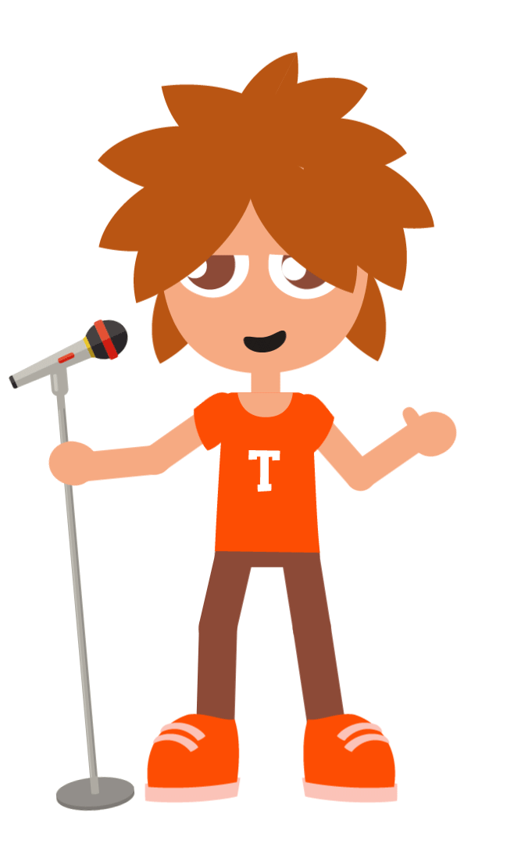
This is Tadhg
Notes:
1 min
Key message: This video is about Thinking Smart about the information and people you meet on the internet
So we know the internet can be so helpful when we are researching things for school, or if a friend moves away, we can still stay in contact with him/her. But, we also know that there are times when we need to be careful online.
This lessons looks at fake news and how to help Tadhg figure out what to trust and what not to trust when it comes to information online. We will also be looking at people online – just like in the real world there are lovely people, but unfortunately there are some people online who may not be who they say they are. They may have bad intentions like trying to scam you out of your money, or they might be an adult pretending to be a child trying to speak to you and maybe even meet up with you. This video will give you top tips on how to recognise this and to know what to do if this happens to you .

Slide 3
Notes:
10 seconds
Key message: When you see this symbol, it means you need to take out your worksheet
Depending on the time you have and the discussion generated by your group, some of the activities on this worksheet are optional

Slide 4
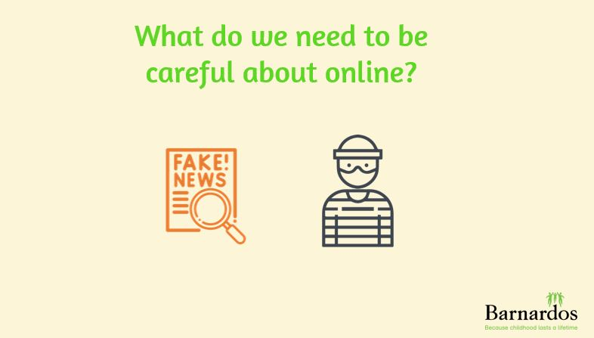
Notes:
30 seconds
Key messages: You need to ‘think smart’ about the things you read and see online, as well as the people you meet online.
So as I explained, this lesson has 2 parts to it – fake news and then people who might try to mislead you on the internet.

Slide 5
How does the internet
help you learn?
Notes:
30 seconds
Key messages: Discussion around how the internet helps people learn/what apps/website children use to learn new things
Barnardos always love to hear from children, which is why the first question is how the internet helps you learn. What apps/websites do you like to use to learn new things from?
Pair work: working with your pod, talk to the person beside you about how you use the internet to learn new things. On the next slide, you’ll see lots of logos/websites that might give you inspiration. I’ll give you 30 seconds to discuss. If there are any websites/apps missing from the next slide that you use regularly, let me know and I can add it.

Slide 6
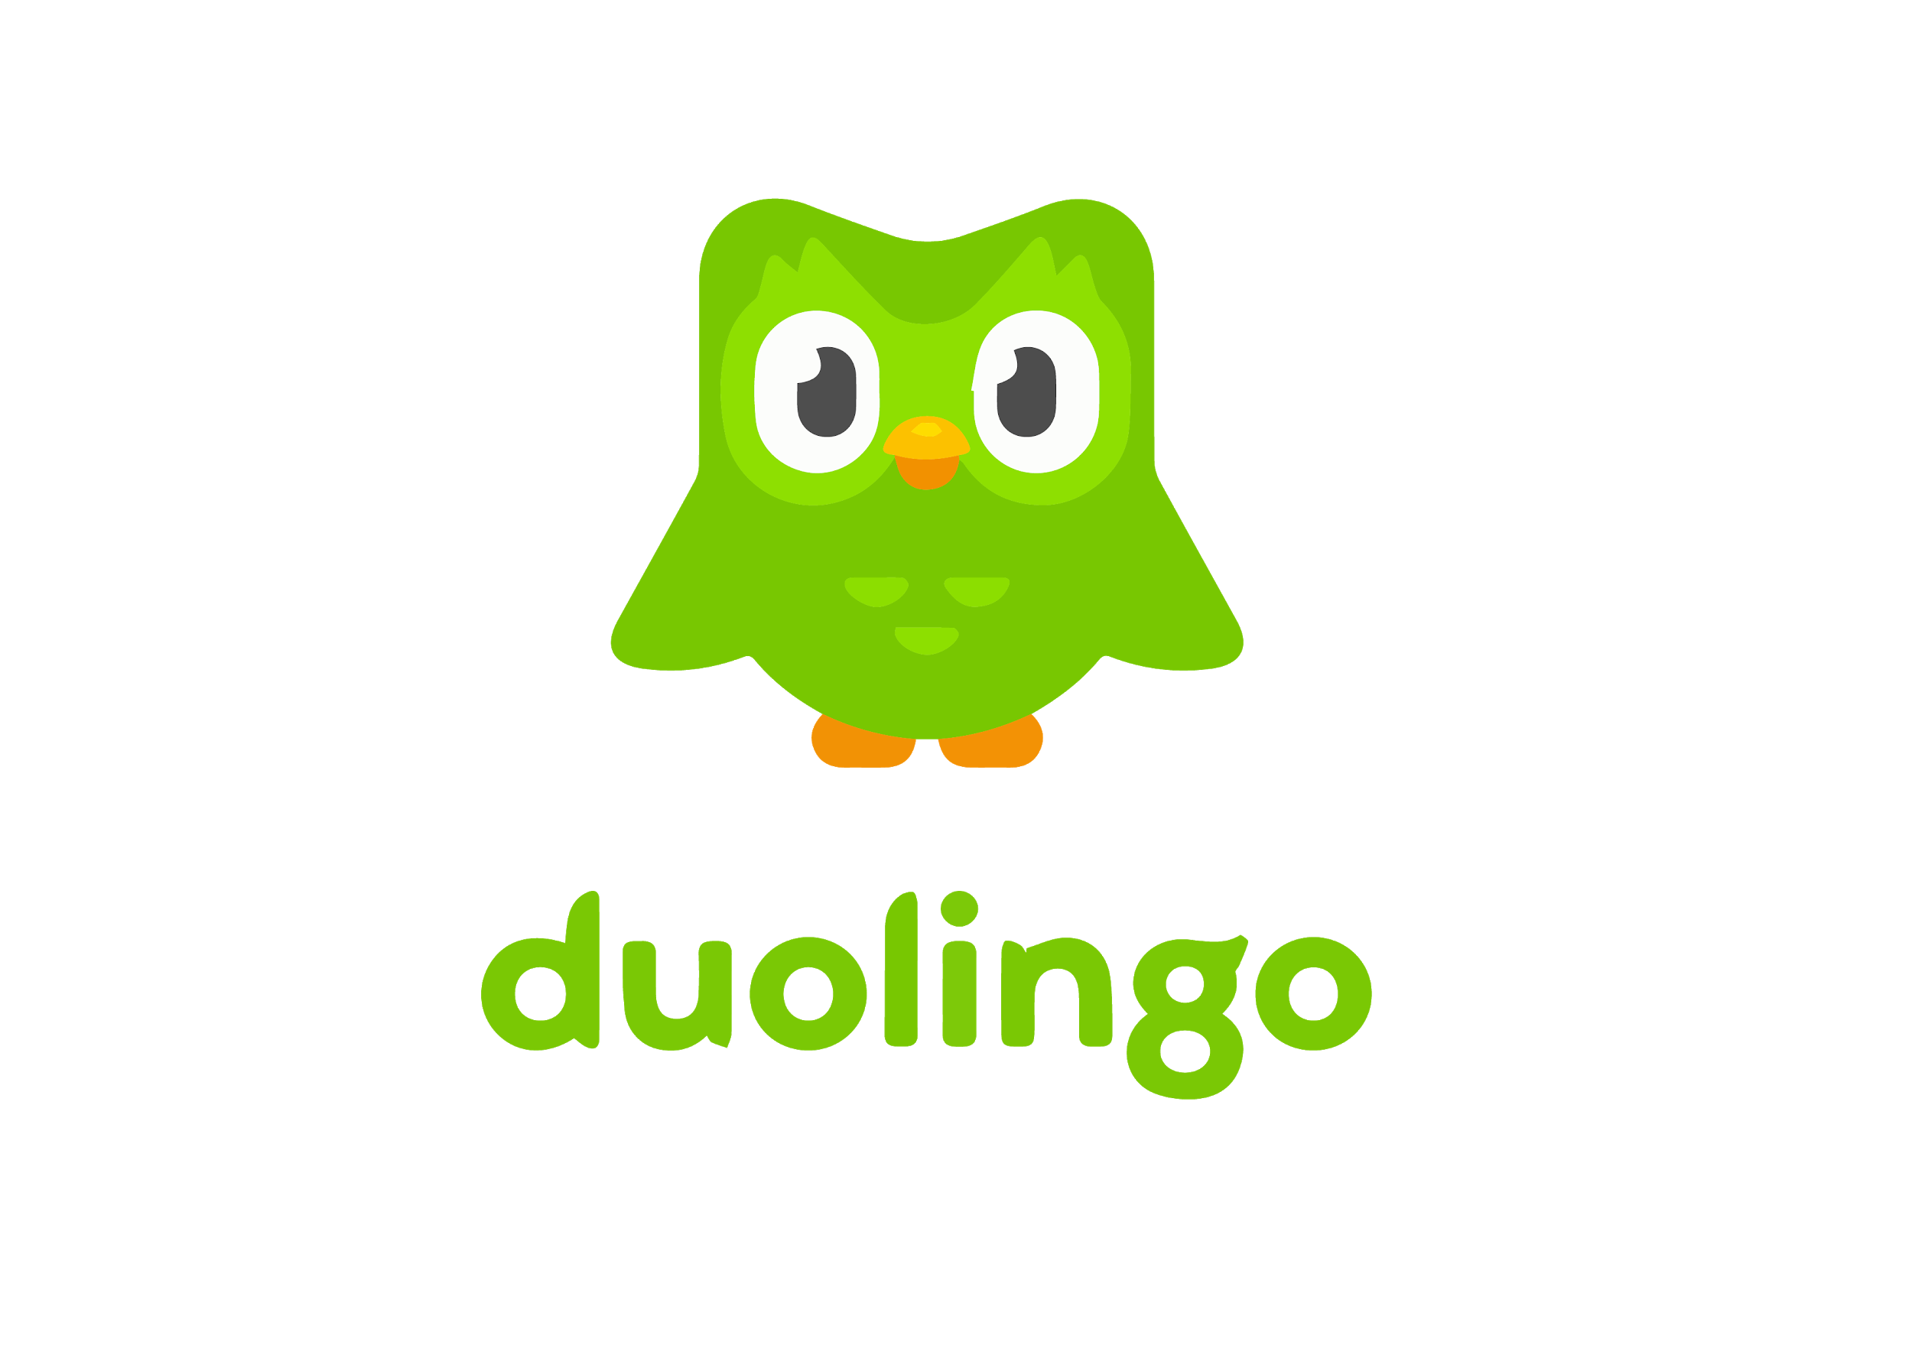
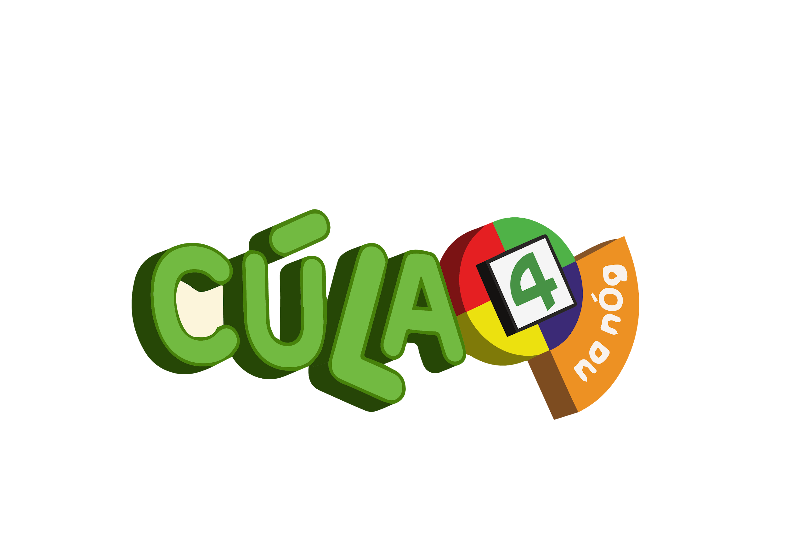
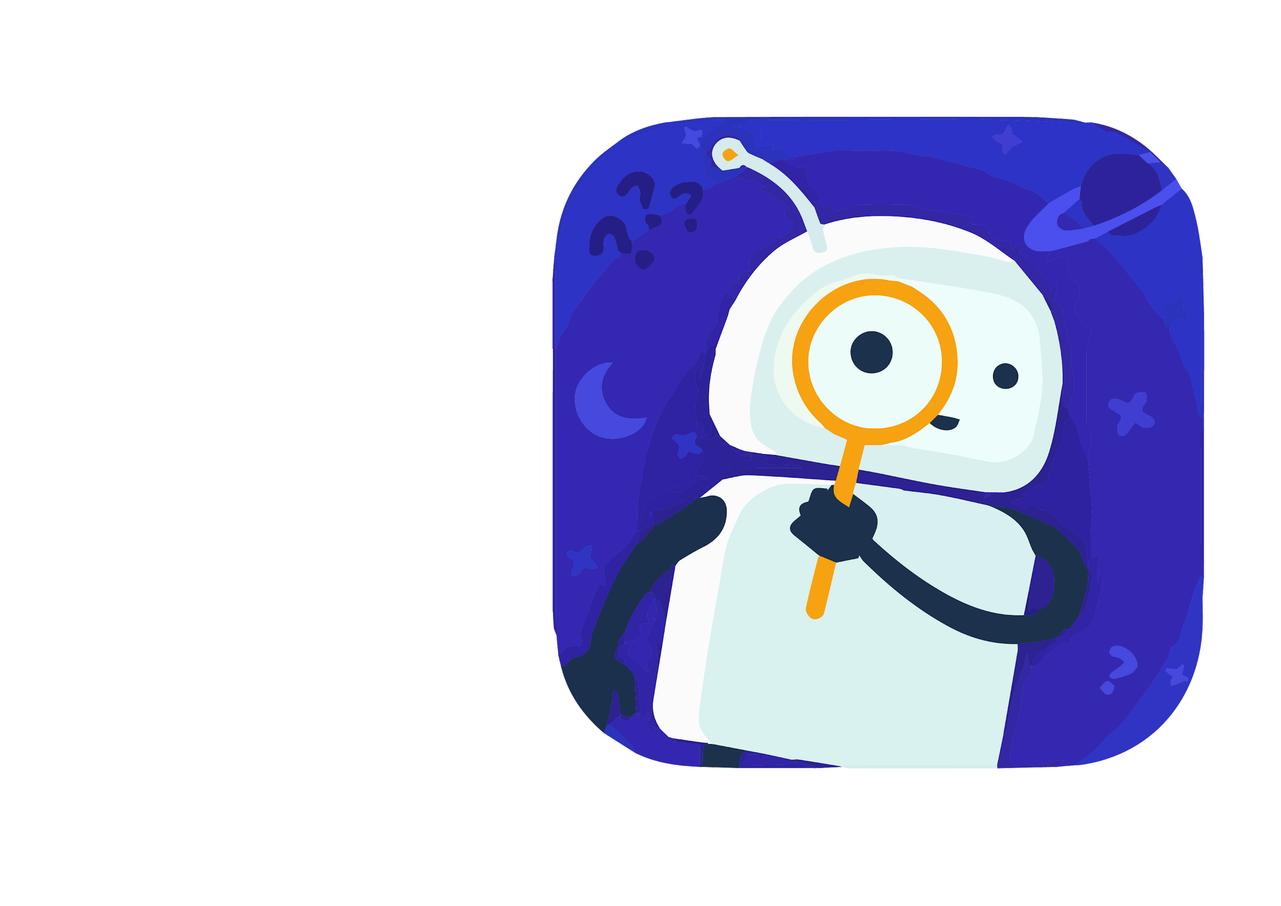
Notes:
30 seconds
Key message: Discussion around how children use the internet to learn and what apps/websites they like to use
Discussion question: How does the internet help you learn? What apps/websites do you use?
Feedback as a group
Wikipedia: a website that functions like an encylopedia. It is a great first step when you’re looking up information online, but be aware that it is ‘user generated’ meaning anyone in the world can edit articles on Wikipedia. Look out for articles that have a lot of references at the end so it is clear where people have gotten their information from. Check other websites too – don’t use Wikipedia as your only source of information.
Tik Tok: you might use this app to learn how to edit videos
Mathetics: An app that tests your maths knowledge in a fun way
Scratch: a programme that help children learn how to code in a fun way
Duolingo: A free app whereby you can learn a new language in an accessible way
National Geographic Channel: there is a sub section here for children that teaches them about the world and about geography/animals
Minecraft: A game that challenges you to be creative and design and build towns/villages
Youtube: an endless supply of educational videos and ‘how to videos’
Cula4: a TV show in Irish
Tappity (blue panda): an app that helps children learn science (age 4-10)
Teacher approved apps on Google - https://blog.google/products/google-play/teacher-approved-apps/

Slide 7
Optional: Do activity 1 on your worksheet
Notes:
Optional (if this is preferred than class discussion)

Slide 8
Notes:
2 mins
Key messages: We need to be careful and ‘think smart’ about the information (pictures and text) we read and see online, and ‘think smart’ about the strangers who may get in contact with us online
What do these two images mean to you?
Can anyone explain fake news to me? Or give me examples of fake news? (Answers: news that isn’t true, headlines that don’t tell the truth/clickbait, conspiracy theories, information that doesn’t have any evidence or proof behind it)
Can anyone tell me why we need to be careful about strangers contacting you online? (Answers: scams, viruses, stealing your identity, stealing your money, adults pretending to be younger to meet up with you)

Slide 9
Is everything on the internet true?
NO!!!!
Notes:
30 seconds
Key messages: not everything online is true, we need to use our brains, use what we know already and ‘think smart’.

Slide 10
What does the word reliable mean?
Optional: Do activity 2 on your worksheet
Notes:
1 minute
Key message: Discussion over definition of ‘reliable’
Pair work: in your pods, talk to the person beside you about what you think the word ‘reliable’ means? Maybe you can think of another word that means the same thing?
Answer: Cambridge English dictionary defines reliable as: https://dictionary.cambridge.org/dictionary/english/reliable
An adjective - Someone or something that is reliable can be trusted or believed because he, she, or it works or behaves well in the way you expect
deserving trust; dependable:
Reliable information is data that is accurate and able to be trusted

Slide 11
What does reliable mean?
Trustworthy
Safe
Accurate
Dependable
True
You can trust it
Honest
Real
Notes:
1 min
Key message: Definition of reliable - feedback
Feedback as a group. What other words did you come up with that mean the same as reliable?
Did any of you come up with these words??
Cambridge English dictionary defines ‘reliable’ as an adjective meaning
Someone or something that can be trusted because it works or behaves in a way that you would expect
‘deserving trust or dependable’
Reliable information is accurate data that can be trusted
https://dictionary.cambridge.org/dictionary/english/reliable

Slide 12
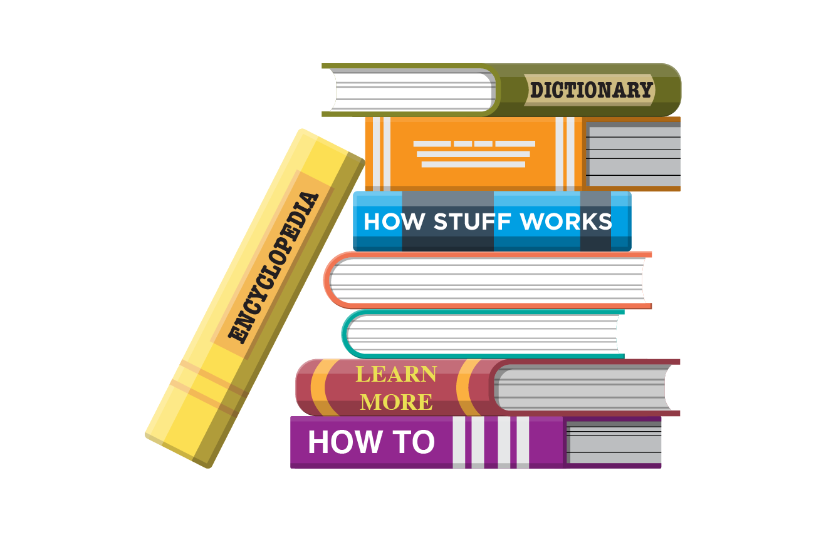
How did we learn things in the past?
Notes:
30 seconds
Key message: In the past, we learned about things from books that were well researched and fact checked.
100 years ago in 1921, how did people learn new things? Yes, they learned it in a book. Or in the encylopedia.
In books, they are usually well researched and there are fact checkers to check it is true before publishing it as a book. Do you think there are always fact checkers on the internet? Unfortunately, there is not. Anyone can have a blog and post whatever they want, as long as it doesn’t hurt anyone else.

Slide 13
Edited photos
Notes:
30 seconds
Key messages: Key things to watch out for online
Unfortunately on the internet, there is not always a fact checker before things are uploaded. Also, there is software that might mislead or allow you to change information or pictures online.
For example, what is happening in this picture?
Yes, it is photoshopped or edited. Do you think it looks like that guy is really sitting on that car? Not really, but if you look at it quickly you might fool some people

Slide 14
Misleading headlines/ clickbait
Notes:
30 seconds
Key messages: Definition of clickbait and how to watch out for them
Click here to be as fast as Usain Bolt in 10 days – does anyone think this sounds realistic? What is the name of headlines like this – that say things that are interesting and makes you want to click on them, but actually they aren’t really true at all. Yes, it is clickbait.
Cambridge English dictionary define clickbait as “articles, photographs etc on the internet that are intended to attract attention and encourage people to click on links to particular websites’.
You might recognise clickbait by the start of the sentence “You won’t believe…” or “What happened next will shock you…
Clickbait might over promise or misrepresent something slightly in order to suck you in. Clickbait is not necessarily ‘bad’, but it is designed to make you want to click on links so that you spend longer and longer online. We need to ‘think smarter’ about this and if something is too good to be true, it usually is.

Slide 15
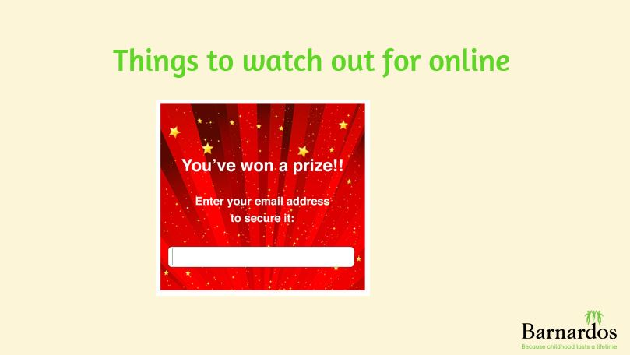
Scams
Notes:
30 seconds:
Key messages: Scams
What is this? Yes, this looks like a scam.
Cambridge English dictionary definition of a scam is “an illegal plan for making money, especially one that involves tricking people”
https://dictionary.cambridge.org/dictionary/english/scam?q=scams
This can be more worrying. Sometimes these scams only want an email address first, but this can be the first step to try hack your account and get access to money, where possible.
Scammers are very good at what they do so we really need to ‘think smart’ about these ones. If something sounds too good to be true, like winning a prize but you don’t remember even entering the competition, this is a scam and you need to ignore it.

Slide 16
Headlines with opinions instead of facts
Notes:
30 seconds
Key messages: To think smart or critically about information, you need to know when something is a fact or an opinion
Looking at the headline ‘Koalas are the best animals in the world, believe me, I know”’ – is there anything that would make you stop or think twice about reading this title/headline? Who wrote this headline? Does it have an author?
Does it matter who says things or who gives information? If an animal expert or a vet were to say this headline, would you believe them more? Maybe you would. Or what if I, as your teacher, just said this – would you trust that koalas are the best animals in the world just because I said it?
Yes, that is why you need to be careful and think smart about WHO is saying things online and if they have evidence to back up their claims. Let’s look now at the difference between facts and opinions.

Slide 17
OPINION
FACT
An idea that someone believes based mainly on their feelings or beliefs
Something that is known to have happened and there is proof to back it up
Notes:
1 minute
Key message: There is a difference between an opinion and a fact. An opinion is based on feelings and there is no ‘proof’ to back it up. A fact is something you can prove.
What is an opinion? (definition to pop up after)
What is a fact (definition to pop up after)
Let’s look at some examples of facts and opinions
Cambridge Dictionary says an opinion is: an idea that someone believes based mainly on their feelings or beliefs
https://dictionary.cambridge.org/dictionary/english/opinion
Cambridge Dictionary says a fact is: something that is known to have happened because there is proof or evidence
https://dictionary.cambridge.org/dictionary/english/fact

Slide 18
According to a survey of 100 people,
88% said koalas were their favourite animals
I believe koalas are the best
Notes:
1 min
Key messages: How to spot an opinion –v- how to spot a fact
Look out for the start of sentences.
How would we know that “I believe koalas are the best” is an opinion? What gives this away? (I believe)
How would we know that ‘according to survey of 100 people, 88% said koalas were their favourite animals”? Why is this a fact and not an opinion? (it is because you have proof from the survey, you can check with the 100 people who responded and check their answers)

Slide 19
In my opinion, Spanish is the nicest and easiest language to learn
In Spain, Spanish is
their national language
Notes:
1 min
Key messages: How to spot a fact –v- an opinion
Opinions aren’t fake news or ‘wrong’ in any way. They are very true for the people who say them. When reading, watching and listening to information on the internet, it is important to remember that opinions are true for that particular person, but may not be true for everyone. This is why it is easier to believe and accept that facts are true. They are not based on anyone’s feelings or belief and you can check the proof/evidence.
What gives the first sentence away (in my opinion). It is clear that Spanish may be easy for that person to learn, but it might not be true for everyone
How do you know the next is a fact? (It uses factual language). You can check in a book or an encylopedia if this is true or not

Slide 20
Do activity 3 on your worksheet
Notes:
3 mins
Key messages: Fill out activity 3 on your worksheet – is it fact or opinion?? How do you know?

Slide 21
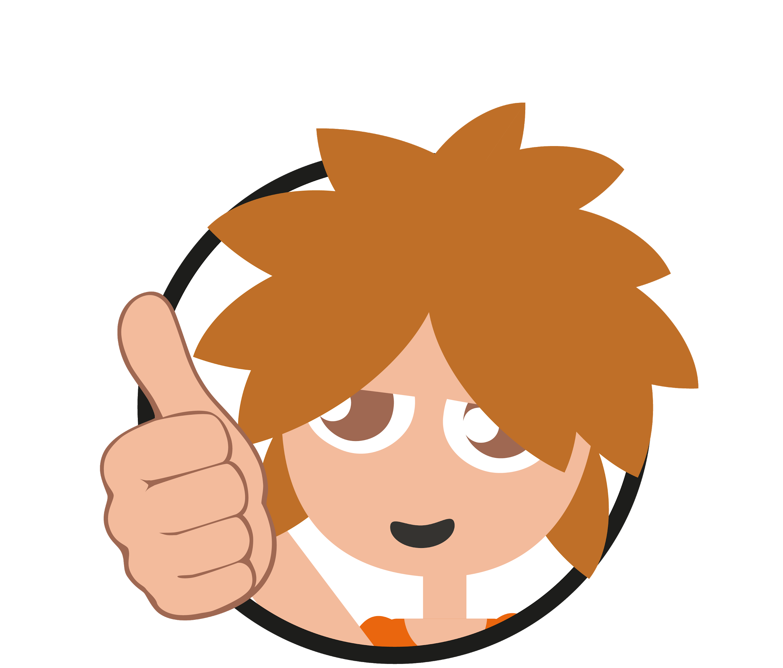
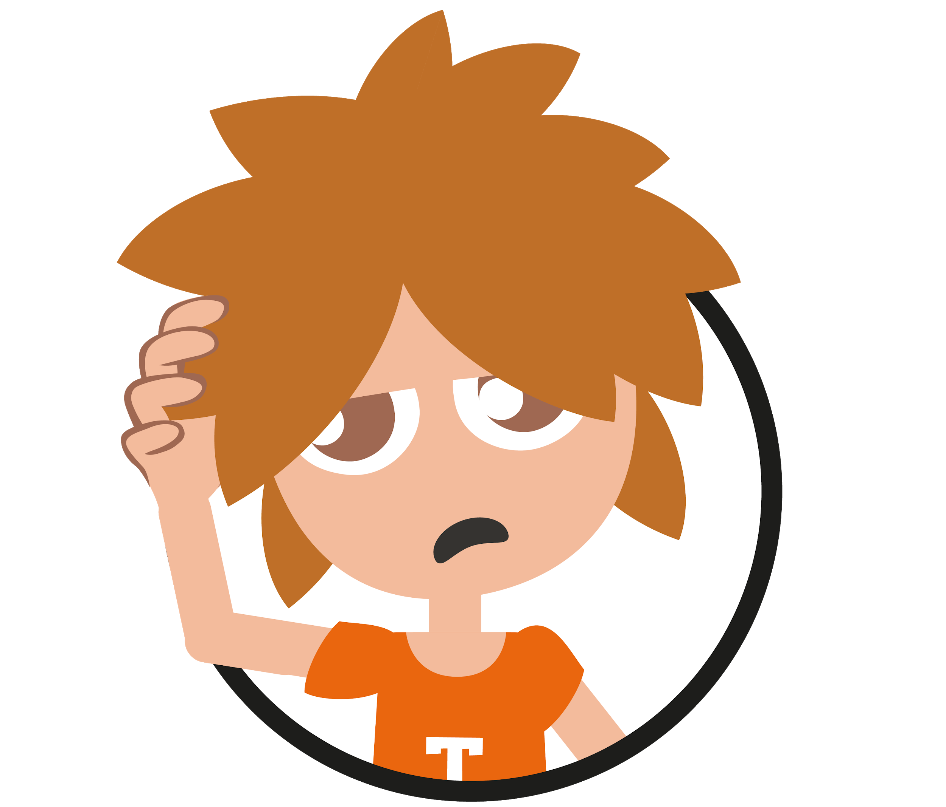
GAME: Think Smart: Is this fact or opinion?
Fact
Opinion
Notes:
7 mins
Key messages: Let’s check your answers to activity 3 by playing a game
Everybody stand up. You’ll see different sentences come up on the screen. If you think it is a fact, give me a thumbs up. If you think it is an opinion, scratch your head.

Slide 22
GAME: Think Smart: Is this fact or opinion?
Roses are the most beautiful flowers, in my opinion.
OPINION
Notes:
Question 1:
Is this fact or opinion? Thumbs up for fact, scratch your head for opinion. Can you give a reason why?
Answer: opinion (reason: in my opinion)

Slide 23
GAME: Think Smart: Is this fact or opinion?
According to a survey with 100 people, 88% don’t have privacy settings on their accounts.
FACT
Notes:
Question 2:
Is it fact or opinion?

Slide 24
GAME: Think Smart: Is this fact or opinion?
I hate peas, they are the worst vegetable. No one should eat them!
OPINION
Notes:
Question 3:
Is it fact or opinion?
Opinion, there is nothing here that gives evidence or proves why peas are the worst, making it an opinion.

Slide 25
GAME: Think Smart: Is this fact or opinion?
I don’t think football training should be on later.
OPINION
Notes:
Question 4:
Is it fact or opinion?
Opinion, reason: I don’t think.

Slide 26
GAME: Think Smart: Is this fact or opinion?
Through research, scientists believe that a vaccine can be possible by the end of the year.
FACT
Notes:
Question 5:
Is this fact or opinion?
Fact (according to research)
Great game!

Slide 27
Let’s put you to the test…
Have a look at these websites. Which would you think are reliable?
Notes:
30 seconds
Key messages: The next activity checks if you can put all your learning together

Slide 28
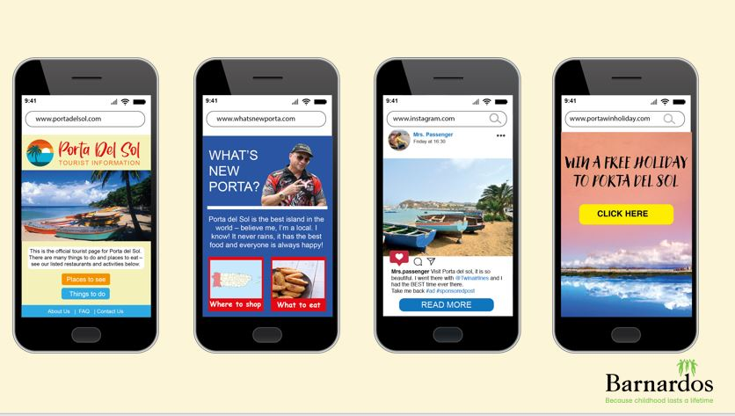
Notes:
30 seconds
Key messages: Look at these websites/posts and see which one is the most reliable
Activity: You are looking up holiday destinations on the internet. You’ve heard Porta del Sol is really nice. You google the word ‘Porta del sol’ and the results, among others, are these 4 websites. By reading the website, by checking for facts/opinions, which website do you think is reliable? You need to ‘think smart’. What website or post would you choose or trust the most?
Pair work: You will see 4 examples come up, I’ll read through them and then with the person beside you, I want you to work together to fill in your worksheet and choose the most reliable website and to explain why it is, and why the others may not be.

Slide 29
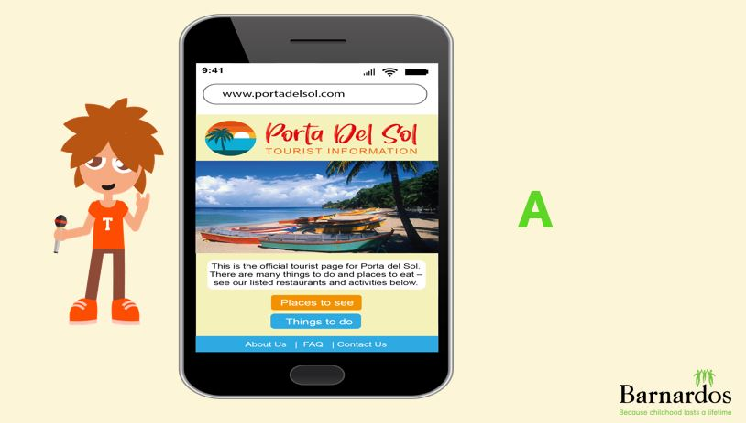
Notes:
1 min
Key message: What is the most reliable and trustworthy website or post? Which one would you trust is giving you accurate and true information?
This is the first option. Read out website URL, and main text of website. Say there is an ‘about us’ section and a ‘contact us’ section at the end

Slide 30
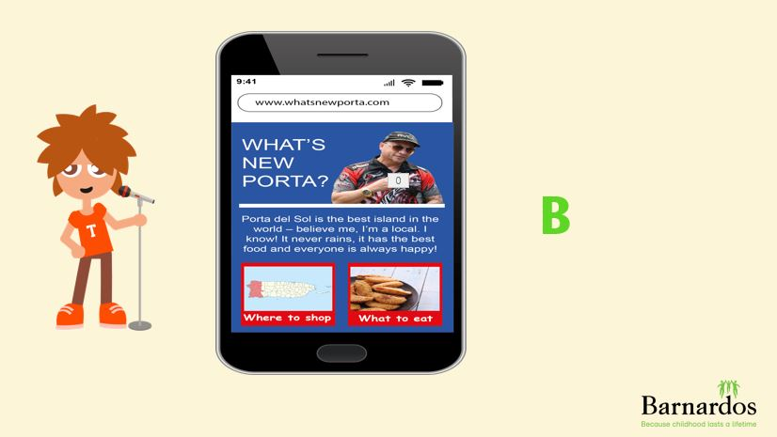
Notes:
1 min
Key message: What is the most reliable and trustworthy website? Which one would you trust is giving you accurate and true information?
The second option is WWW.WHATSUPPORTA.COM. Read out what it says
It looks to be a blog written by a local. There is no ‘contact us’ section.

Slide 31
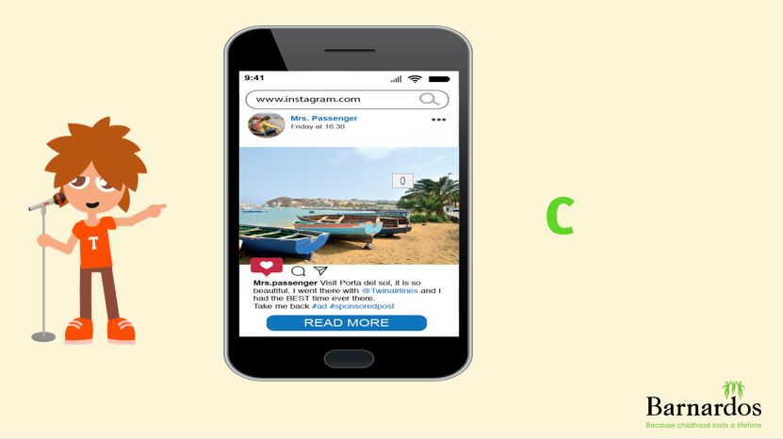
Notes:
1 min
Key message: What is the most reliable and trustworthy website or post? Which one would you trust is giving you accurate and true information?
Third option (C) is an Instagram post by Mrs Passenger who says “visit porta del sol, it is so beautiful. I went there with @twinairlines and I had the BEST time ever. Take me back #ad #sponsoredpost

Slide 32
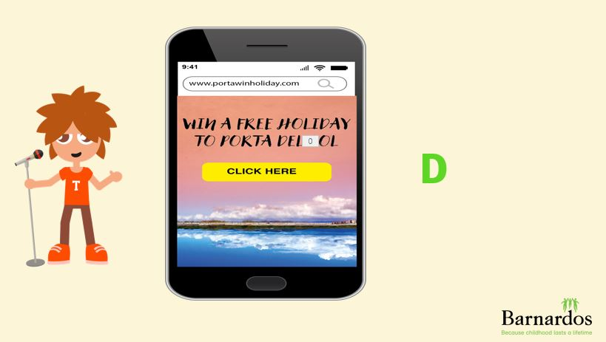
Notes:
1 min
Key messages: What is the most reliable and trustworthy website or post? Which one would you trust is giving you accurate and true information?
The 4th option or D is WWW.PORTAWINHOLIDAY.COM and says to win a free holiday to porta del sol, click here

Slide 33
Do activity 4 on your worksheet
Notes:
3 mins
Key messages: Pair work to complete activity 4
Work together with the person beside you to complete activity 4.
Which website/post do you think is the most reliable or gives the most trustworthy information? Give reasons why. Look out for facts and opinions and other ways of checking if websites are reliable…

Slide 34
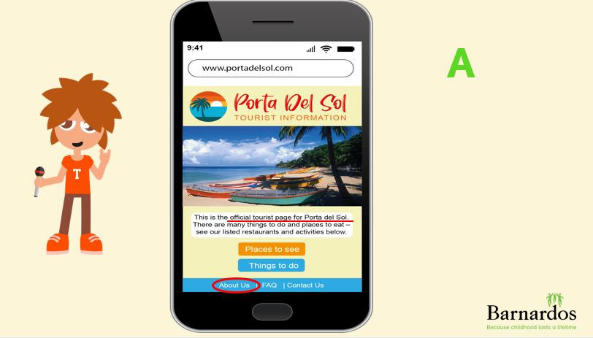
FACTS
Notes:
30 seconds
Key message: Correcting worksheet
Yes, well done. A) www.portadelsol.com looks to be the most reliable website. Why is this?
It uses facts, not opinions
It is the official tourist page
There is an about us section
There is a contact us section (so you can check it is run by a real person)

Slide 35
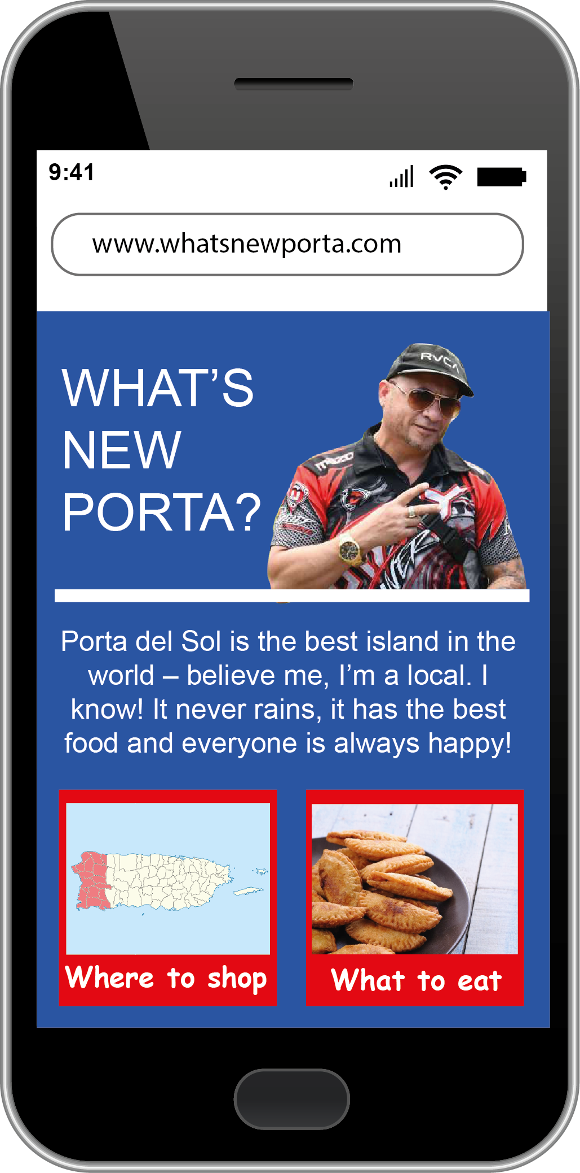
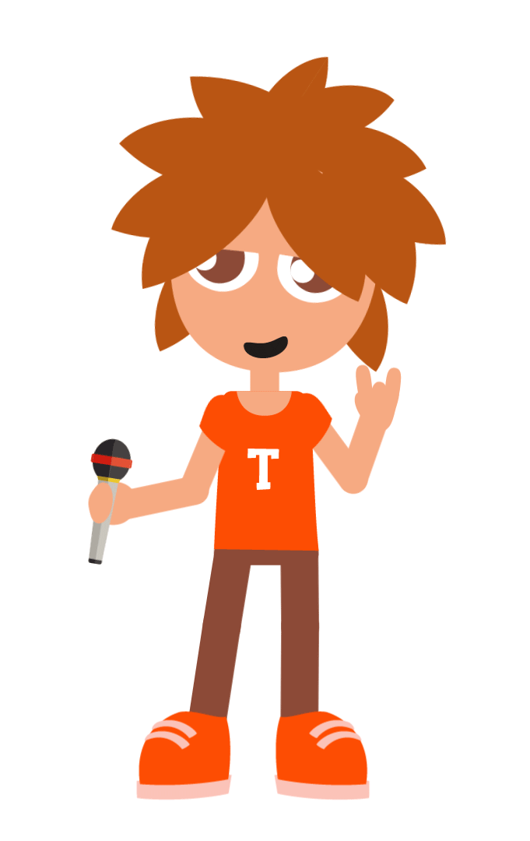
B
OPINIONS
Notes:
30 seconds
Key messages: Correcting worksheet
Yes, well done, B doesn’t look to be the most reliable as it is mostly opinions and doesn’t back up points. Although it is good that it is written by a local, it has no ‘contact us’ section and doesn’t explain or give evidence how it has the best food and how everyone is always happy

Slide 36
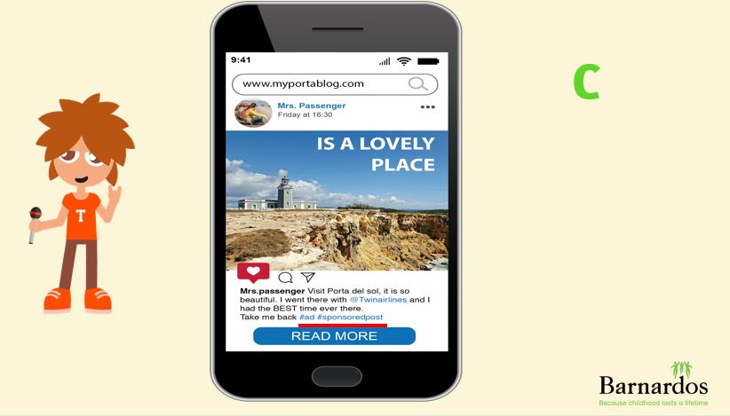
Paid for post by an influencer
Notes:
30 seconds
Key messages: correct worksheet
Well done, it is important to think smart about this post. It is a #ad or #sponsored post meaning that the person writing it is getting money to write it. This might mean that they say very positive things, even though it might not be honest.

Slide 37
This could be a scam
Notes:
30 seconds
Key messages: correcting worksheets
Well done, this doesn’t look very reliable. It looks like a scam. It seems too good to be true.

Slide 38
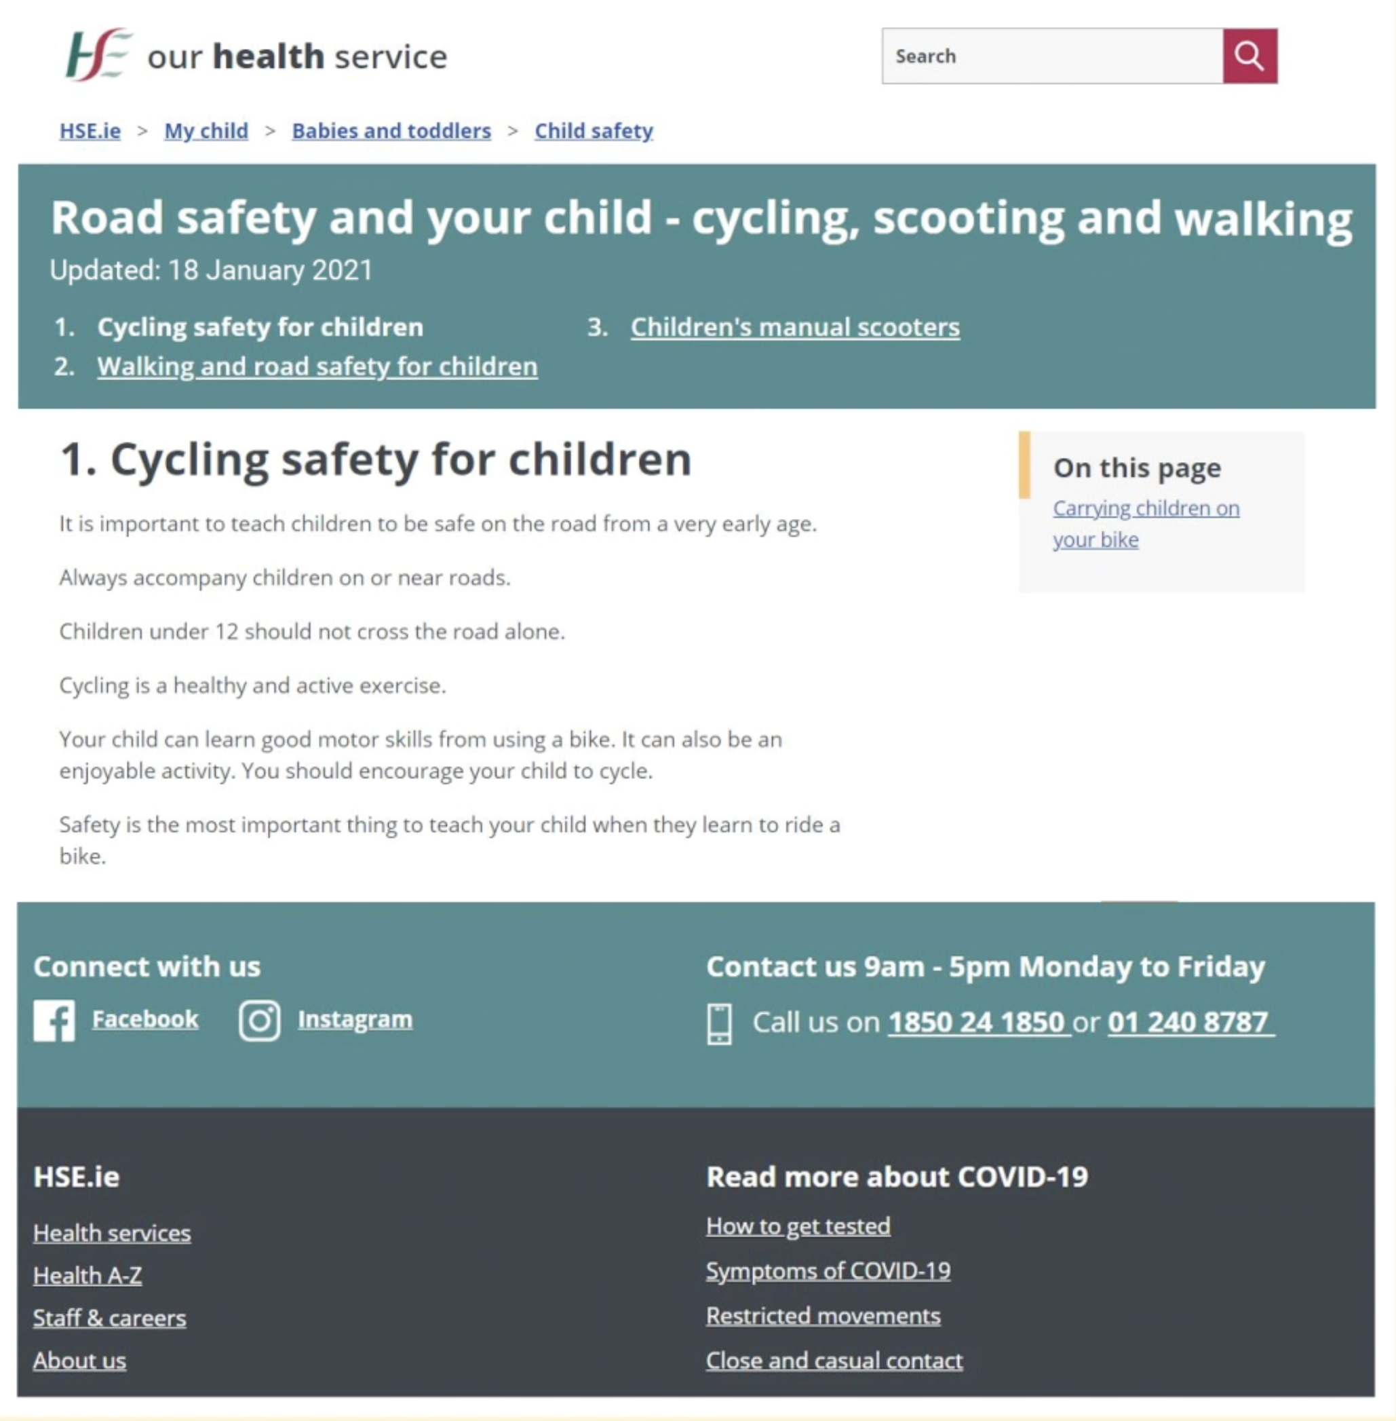
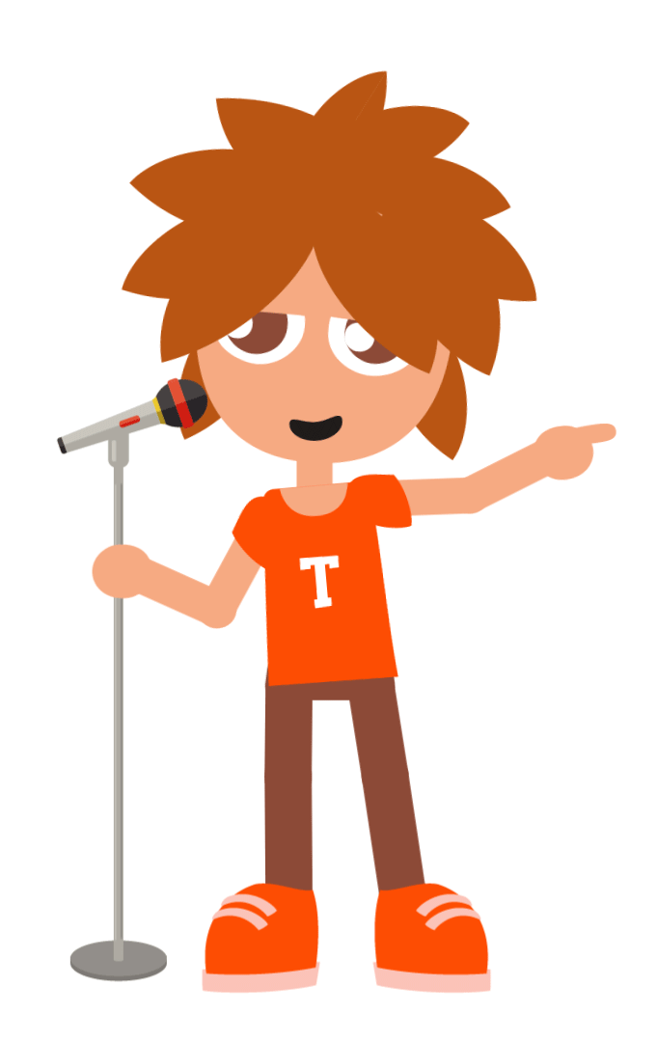
Notes:
1 min
Key messages: How to spot a reliable website
Here is an example of a reliable website. It is a HSE website, so firstly you may know the name of the organisation HSE already which helps make it reliable
It is updated recently so you know the information is up to date
It gives facts, not a lot of opinions
It has ways to contact them so you know there is a real person behind the website
It has an ‘about us’ section so you can learn more about the organisation

Slide 39
Notes:
2 mins
Key messages: Top tips for checking information online
If you’re not sure, check with a trusted adult. This is a great thing to do. There is so much information on the internet, it can be hard to know what is right and what is misleading, once you’ve done some research, check with your parents or teachers if it sounds OK. You can also check with them what reputable or reliable websites to use.
Think smart! Use your brain – you already know so much information already. When you’re reading new information, think smart and check does it make sense from the other information you have. If it doesn’t, research a bit deeper or disgard that information.
Check 3 websites – this asks you not to just accept the first website that comes up on Google as the most reliable. Sometimes there is a ‘ad’ button beside these first results, and similar to the #ad or #sponsored post on Instagram, it just means they’ve paid to be the first results on Google. It doesn’t make the information in it more reliable. Check with 3 websites in total before accepting something is true.
Who wrote it and when was it updated, is there an about us section? We know that if certain people say things, you may believe them more – experts, scientists, historians (people who have worked a long time in this area and so we trust that they know it). If you’ve never heard of the organisation, or if it is an article on the Irish times or RTE, you may trust the Irish times more as you know who they are. Always check when the information was updated as sometimes information goes out of date, or you may not be getting the most up-to-date news.
Does it sound too good to be true? This is for scams. As we said, scammers are really good at what they do so just take a second before clicking on things that say you will win a prize, you might get a virus on your computer or phone instead…
Are the images realistic or photoshop – this can be hard to tell but often people on social media add filters on to photos so you may not be getting the full picture. Always think smart about images or even videos you see and ask questions if you don’t think they seem realistic.

Slide 40
Be careful about people online
Notes:
1 min
Key messages: It is important to think smart about strangers online
Moving on to the second part of our lesson, we know we need to think smart about the information we read online. We also know we need to think smart about strangers or people online too.
Why do you think that is? Can anyone give me examples of when a stranger online might try to mislead or trick you? (scams, identity theft, sending you viruses, cyberbullying, an adult pretending to be younger so they can meet you)

Slide 41
When do you speak to friends online?
On video games
On social media
On your phone through texts / calls
Notes:
1 min
Key messages: Discussion around when do we speak to others online
When do we speak to your friends on the internet? –video games/social media/on phone
When might you speak to strangers online? As in, people who you may have added online, but you don’t actually know them in real life. They could be friends of friends, but you have never met them before.
Video games, when you get emails or messages from strangers (if you have an email address), if you get phone calls from strangers
We know that to stay safe online it is always best to only speak to people that you know in real life. If anyone does ‘friend’ or ‘add’ someone they don’t know, they are a stranger and it is so important that you don’t share your personal information with them. Remembering our other rules – what does personal information mean? (address, phone number, email address, first, last name, age, where you go to school)

Slide 42
Notes:
30 seconds
Key messages: Examples of when and why strangers might contact you online
You might get a message like this on the family computer from a stranger– this is a scam. It usually looks real, but sometimes if you download new software to ‘get rid of viruses’, it actually just gives you a virus instead.

Slide 43
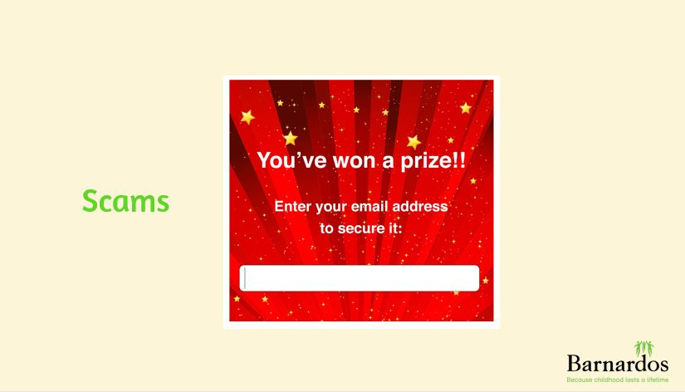
Notes:
30 seconds
Key messages: How and when a stranger might contact you online
Again, we know this from before. Think smart about things that seem too good to be true. Be wary of things that pop up looking for email address/phone numbers claiming that you’ve won something. This is probably not true and could be a scam or a virus.

Slide 44
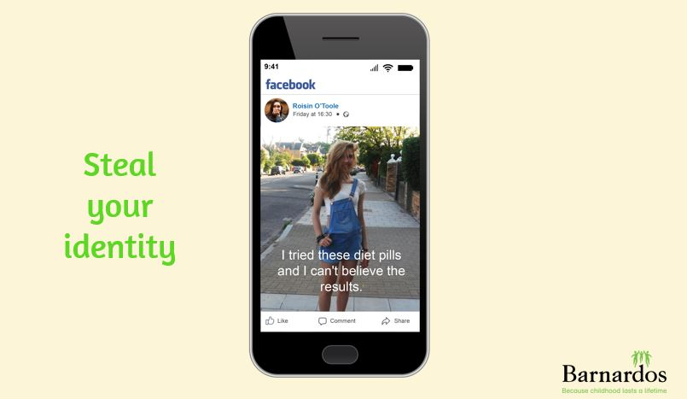
Notes:
30 seconds
Key messages: How and why strangers may contact you online
This shows a facebook profile that looks to be hacked. This is Roisin O Toole but her profile picture looks nothing like the picture she has posted. Sometimes what can happen if a stranger contacts you and you give them your password, or they guess your password. They can hack into your account and sometimes pretend to be you.
You can report hacked accounts and get them taken down
Facebook - https://www.facebook.com/help/hacked
Instagram - https://www.facebook.com/help/instagram/370054663112398?helpref=uf_permalink
Snapchat –block and report the account that you think is impersonating you - https://support.snapchat.com/en-US/a/report-abuse-in-app
Tik Tok – https://www.tiktok.com/safety/resources/impersonation?lang=en
Real life story: 30 seconds – my tik tok got hacked and almost ruined my life - https://www.youtube.com/watch?v=DtHXsa5l3bA

Slide 45
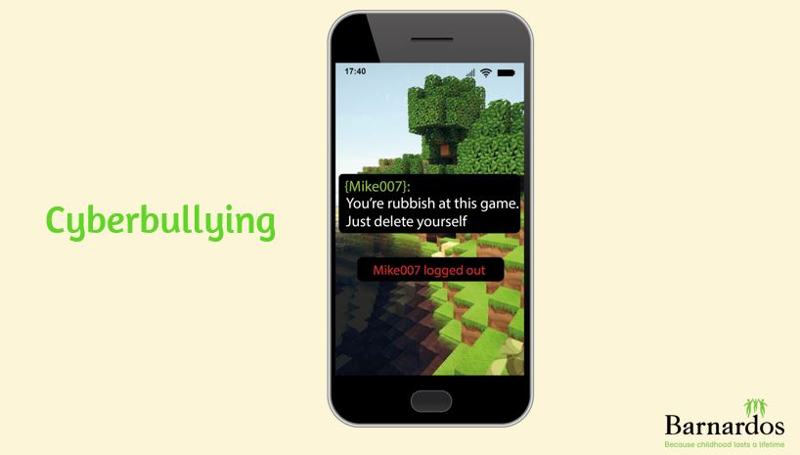
Notes:
30 seconds
Key messages: How and why strangers contact you online
Sometimes children may play games with strangers online. This is never ideal as you wouldn’t really play with a stranger on the street? In some sad situations, these strangers can send you mean, sometimes anonymous comments. ‘Griefers’ are people who play online games, but instead of playing the games properly, they set out to annoy or kill others in the game.
If this happens to you, you should always tell your parents. You can also block and report these players so they don’t ruin your enjoyment of the game.

Slide 46
Notes:
30 seconds
Key message: How and why strangers may contact you online
We know we should only play online games with people we know in real life. However, there are some people on the internet who are very skilled at pretending to be younger than they are. They might seem really friendly and nice, and might say lots of nice things to you. They may seem like your friend and they might ask for a photo, or even to meet up with you in real life. They also might ask you to keep your messages a secret from others.
See here how username1234 speaks to Tadhg.
Always think smart about messages from strangers online. It doesn’t matter how nice they seem, they are a stranger and it so important that you tell your parents or a trusted adult if you ever get messages that make you feel uncomfortable. You won’t get in trouble. If anyone is asking personal questions, asking for a photo or to meet up, you can block them and report them and ALWAYS tell a trusted adult. Sometimes the guards have to be involved as well.

Slide 47
Be careful of strangers online
What school do you go to?
Want to meet up?
How are you?
Where you from?
What age are you?
You’re good at this game!
You’re so beautiful.
Notes:
1 min
Key messages: be careful of strangers online – they might ask questions like this
If you don’t know a player you’re playing online games with in real life, they are a stranger. Be careful if they ask you personal questions like these, flatter you or ask you to move to a different platform or ask you to keep your messages a secret.
Always tell a trusted adult, you can block and report these people.

Slide 48
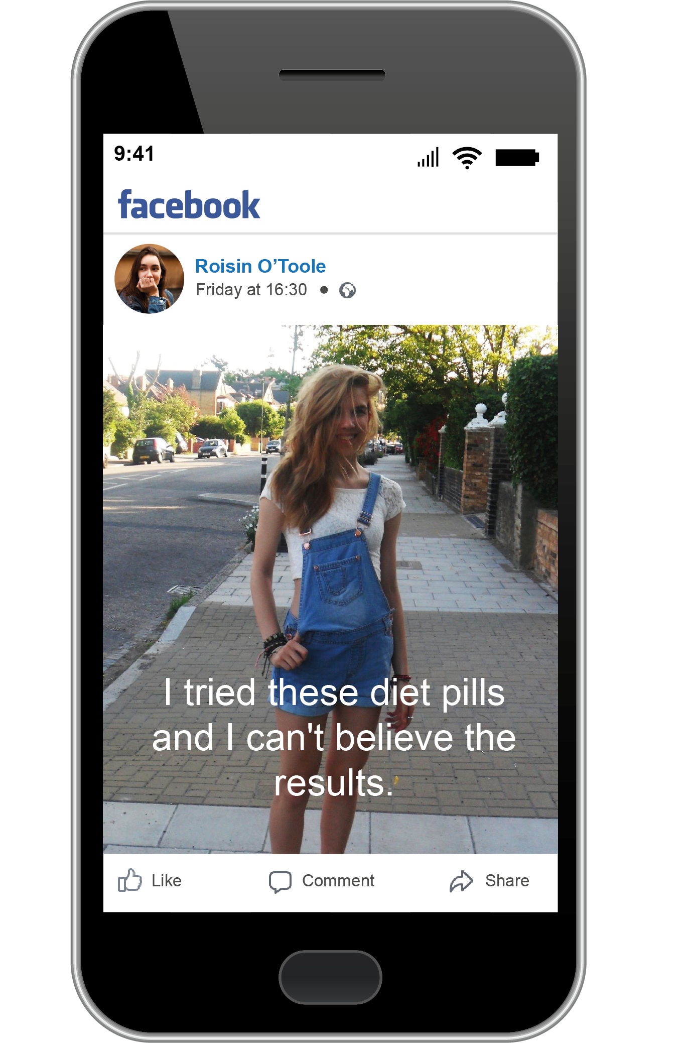
Be careful of fake accounts
Notes:
1 min
Key message: Be careful of fake accounts
We know from before that some people may want to steal your identity – like the Facebook post from Rachel O Toole. We need to ‘think smart’ before adding anyone onto our gaming or social media platforms by making sure we know them in real life and also that they are not fake accounts.
Some people are ‘Tik Tok’ famous or are influencers on Instagram and Youtube and have thousands of followers. Be careful about what you believe here as it can be easy to ‘buy’ followers. Let’s see if we can figure out what accounts are real and what accounts are fake by thinking smart
A journalist that ‘bought’ Tik Tok followers - https://www.vice.com/en/article/z3e8na/get-buy-tiktok-followers-likes-views-cheap-easy

Slide 49
Notes:
5 mins (for full activity)
Key messages: Figure out which one is the fake account
Imagine you’re finally allowed to have a Instagram account and you want to add your friend’s cousin, Harry Smyth. You search for his name and you find two Harry Smyth accounts. By looking at the accounts, which one do you think is real?
Pair work: do this investigation work with the person beside you and fill out your reasons why on your worksheet. You will be able to see the two accounts better on the worksheet.
Some clues – Look at the names and look at the amount of followers they both have. Which one looks more realistic?

Slide 50
Do activity 4 on your worksheet
Notes:
5 mins (for full activity)
Key messages: complete activity 4 on worksheet, discussing your answers with your partner
Which one is the fake account and WHY?

Slide 51
Notes:
2 mins
Key message: Feedback answers
Which one is the fake account? Answer B (reasons why on next slide)

Slide 52
Notes:
2 mins
Key messages: Reasons why B is a fake account
Spelling of his name is different – Harry.Smith (not Smyth)
He only has 4 posts, but he has 1700 followers. This doesn’t seem realistic
He doesn’t have any pictures of himself. Although this is good that he is not revealing personal information, it makes it harder to know who he is.
He is followed by followers who don’t appear to have real names ‘gamergirl000222’, ‘follow4follow_994’. These look like fake accounts, or ones that you can buy. They can actually be robots or ‘bots’ and they are not real at all
Top tips on finding fake accounts (6th class)
Check when the person first joined the platform. If you joined 3 days ago and have 1000 followers or friends, this is a fake account
Check the username profile and name – does it sound like a real name? (Instagram/Facebook have a ‘real name policy’ meaning that on their platform, you need to use your real name, not a nick name. They say this helps with being able to identify fake accounts.
Does the person post the same content all the time? It could be a machine/robot and not a real person
How many followers do they have – is this realistic?
Always check with your friend how they spell their username so you’re sure you’re adding the right person

Slide 53
Notes:
3 minutes
Key messages: top tips for thinking smart online re: information + people

Slide 54
Notes:
30 seconds
Key message: recap on the rules to be STAR online
Hopefully you now feel like you’re able to THINK SMART online when it comes to information and people online. Thank you for helping Tadhg. Watch out for more videos soon!

Slide 55
https://beinternetlegends.withgoogle.com/en_ie
Notes:
30 seconds
Key messages: Be Internet Legends is a website that Google owns.
On it, there are lesson plans for teachers that expand on the think smart idea. It looks at phishing and scams. There are also resources for parents.
There is also Interland, which is an online game about online safety for children aged 7-11. There are 4 lands and they get to test their knowledge about being smart online.

Slide 56
Notes:
30 seconds
Key messages: explaining the different lands on Interland
Reality river looks at scams and phishing and you need to decide if a message looks OK or not
Mindful mountain looks at who you should share personal information with
Tower of Treasure looks at how to build strong passwords
Kind kingdom looks at cyberbullying and how to be an upstander online

